Slide 1
Objective 206.01 5% Understand advanced production methods for digital video.

Slide 2
Pre-Production
Meet with the client to create a project plan:
Determine the purpose of the video production.
Define a target audience.
Set overall goals of the video.
Agree on deadlines for phases of the project.
Create a budget for the production.
Decide what equipment will be necessary to create the video project.

Slide 3
Pre-Production
Script Writing
Script is needed to tell the actors (both on screen and for a voiceover) what to say and when. The script also gives direction to set lighting, sound effects, and other components of the project.
It is important to consider the following:
The overall goals of the video project.
The target audience of the project.
The accepted vernacular of the target audience.
The readers (performers) of the script.

Slide 4
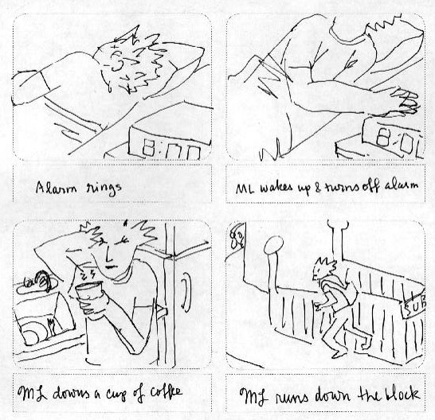
Pre-Production
Create the storyboard:
Sketch out a visual representation of each major scene or major phase of the video project.
Provide information about the audio sources, camera movements, and transitions.

Slide 5
Pre-Production
Create a shot list in the sequence of the storyboard for the camera operators.
Get any actors or other on-camera participants to sign a talent release document.
Gather and manage information and digital assets provided by the client.
Create a file-naming convention to assure proper organization and storage.
Save and organize files for easy and quick access.

Slide 6
Pre-Production
Choose appropriate equipment:
Choose camera(s)
Choose microphone(s)
Choose cables
Other equipment (video mixer).
Mostly used for live video productions.
Accepts multiple camera sources and combines them into one production.
Can automatically add transitions and effects to the input sources.

Slide 7
Production
In video production, the production phase consists only of recording footage with a camera.
NO editing!

Slide 8
Post-Production
Capture and name video footage.
Edit video footage to match project needs.
Apply special effects.
Add audio.
Add transitions.
Add titles.
Export final video to selected format.

Slide 9
Post-Production
Re-design the video production on client feedback (if necessary).
Render the video and re-export after addressing feedback.
Watch the exported video in its entirety to check for quality assurance.

Slide 10
Post-Production
Optimize based on specific client needs:
File Format Requirements
Video files also use codecs.
File Size Requirements
File Name Requirements

