Slide 1
Objective 204.02 3% Select and utilize tools for digital animation production.

Slide 2
Interactivity Terms
Action Script
The language of computer code that is used by Adobe Flash to create user interactivity in animations (buttons, controls, links, etc.).
Script Assist
A feature found in the actions panel that can be used to generate ActionScript without writing code from scratch.

Slide 3
Interactivity Terms
Code Snippets
Small blocks of ActionScript that can be applied to an object or the animation in general.
Instances
Editable copies of symbols that can be changed individually after dragging them from the library.

Slide 4
Interactivity Terms
Button State
The specific visual appearance of an interactive button that corresponds to the particular phase of interaction.

Slide 5
Interactivity Terms
Up State
When the button is not rolled over or pressed down; the normal appearance of a button.
Over State
When the mouse cursor hovers over the button.
Down State
When the button is clicked and held down.
Hit State
Not a visible change; the clickable area of the button or hot spot.

Slide 6
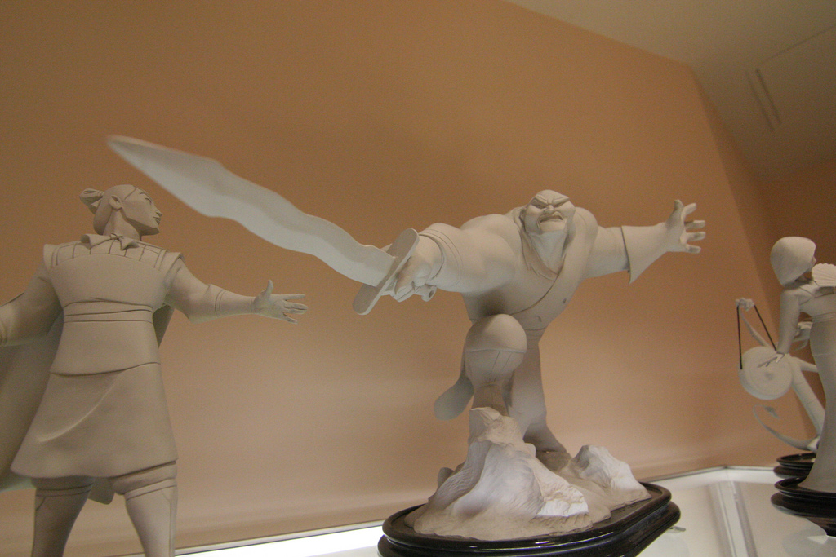
Advanced Motion Terms
Moquette/Model
A physical representation of characters or objects that is used to ensure realistic movement.
Animators adjust the moquette or model into a specific pose and then use it as a guide to model a virtual counterpart or create lifelike animation.

