Slide 1
Objective 204.01 3% Understand advanced production methods for digital animation.

Slide 2
Pre-Production
Determine the overall purpose of the project.
Define the intended target audience.
Agree on deadlines for phases of project.
Create a budget.
Select color scheme and typography.

Slide 3
Pre-Production
Choose the appropriate software.
Adobe Flash
Former standard 2D animation software that is used to create games, advertisements, websites and more.
Adobe Animate
An HTML-based 2D animation software that specializes in creating animations for the internet using HTML5 code. Replaces Flash.

Slide 4
Pre-Production
Choose the appropriate software.
Maxon Cinema 4D Studio/Autodesk Maya
The industry standard 3D animation software that creates three-dimensional models and animates them in a virtual environment.

Slide 5
Pre-Production
Gather and manage digital assets.
Convert files
Make sure files are in the proper format in order to access and edit them in the software.
File-naming convention
Come up with a consistent way to name all files to assure proper organization.
File organization
Organize all files in appropriate folders for easy and quick access.

Slide 6
Pre-Production
Create storyboard.
Sketch out each major scene or phase of the animation. Provide the client with detailed information describing what’s happening in each scene.
Identify transitions between scenes.
Describe other parts of the animation such as audio, interactive buttons, etc.

Slide 7
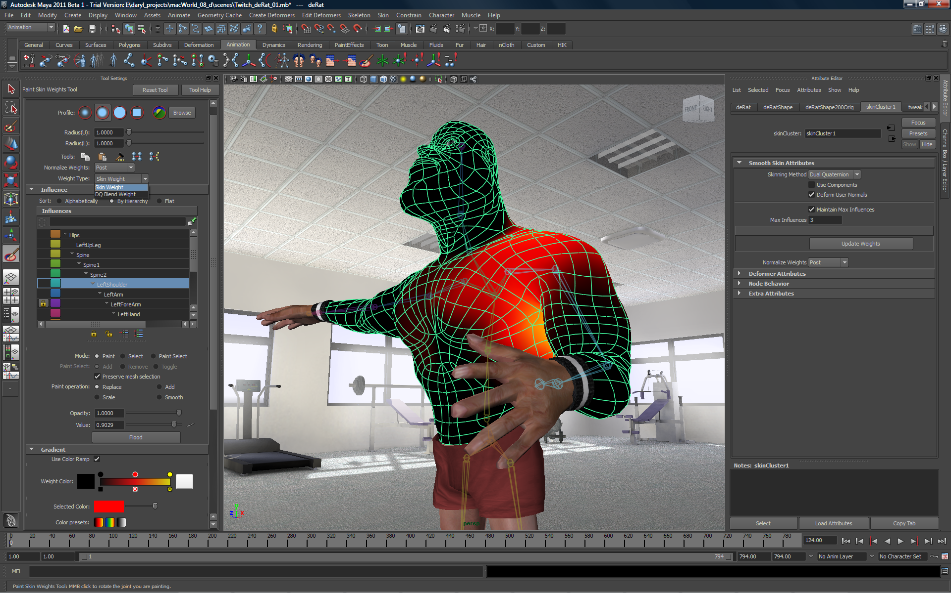
Production
Import existing graphics, audio and/or video into library of animation project.
Draw or create original graphics and place them on independent layers.
Animate the objects according to the storyboard.

Slide 8
Post-Production
Debug the animation.
Preview the animation and check for undesired movement or errors.
Use a debugger program to check the ActionScript code for syntax or omission errors.
Address any errors that are detected.

Slide 9
Post-Production
Export/Publish the animation.
Choose the correct file format based on client requirements.
Distribute the exported animation for client review.
Preview and check for errors.

Slide 10
Post-Production
Optimize the animation output file for specific client needs, including:
Primary use of animation
File size requirements
File format requirements

