Slide 1
Objective 203.03 5% Execute advanced production methods to create imaging and design.

Slide 2
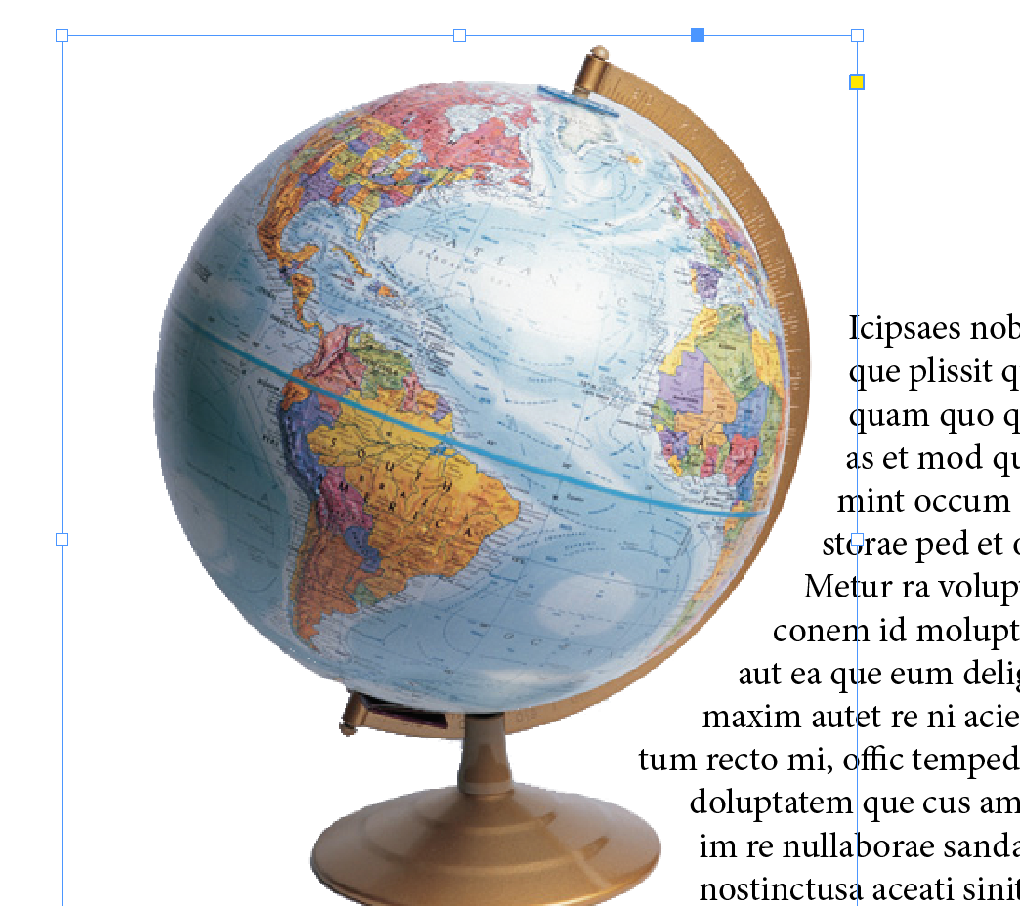
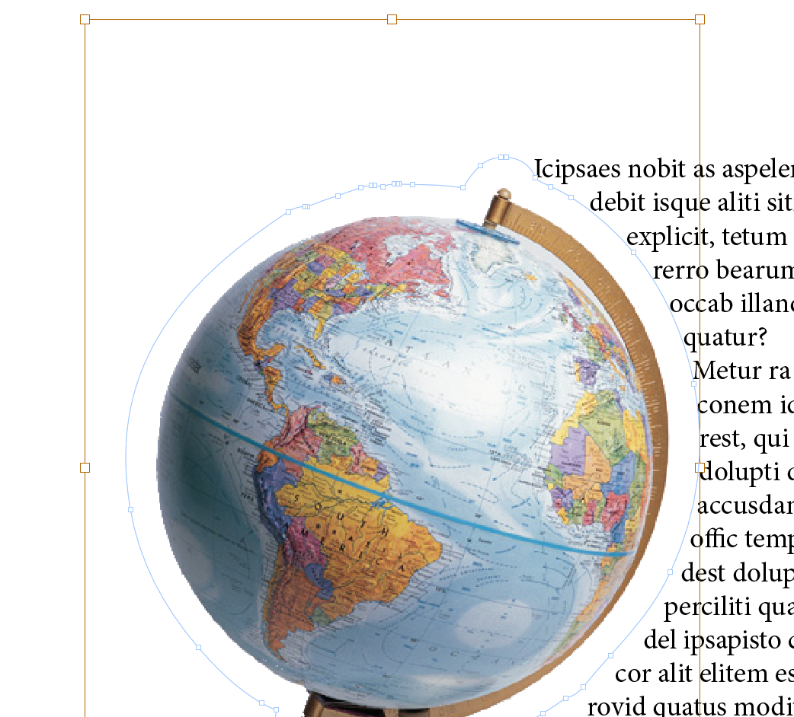
Selection vs. Direct Selection Tool
Selection Tool
Lets you select the entire object.
Identified by blue frame.
Direct Selection Tool
Lets you select contents within the frame.
Identified by orange frame.
Use to move object within blue frame.

Slide 3
Drawing Tools
Pen Tool
Draw straight and curved paths.
Same as Pen Tool in PhotoShop and Illustrator.
Add or Delete Anchor Point Tool
Add or remove anchor points from path
Frame Tools
Creates placeholder frames

Slide 4
Transformation Tools
Free Transform Tool
Rotate, scale or shear an object.
Rotate Tool
Rotate objects around a fixed point.
Scale Tool
Resize object around fixed point.
Keeps proportions.
Shear Tool
Skew objects around fixed point.

Slide 5
Character vs. Paragraph Styles
Styles can be created one time and easily applied to text. If the style is modified, all text to which the style has been applied is automatically updated.
Character Style
Includes formatting such as font, size, bold, italics and color, etc.
Paragraph Style
Includes paragraph formatting such as indents, bullets, and alignment as well as the character formatting options.

Slide 6
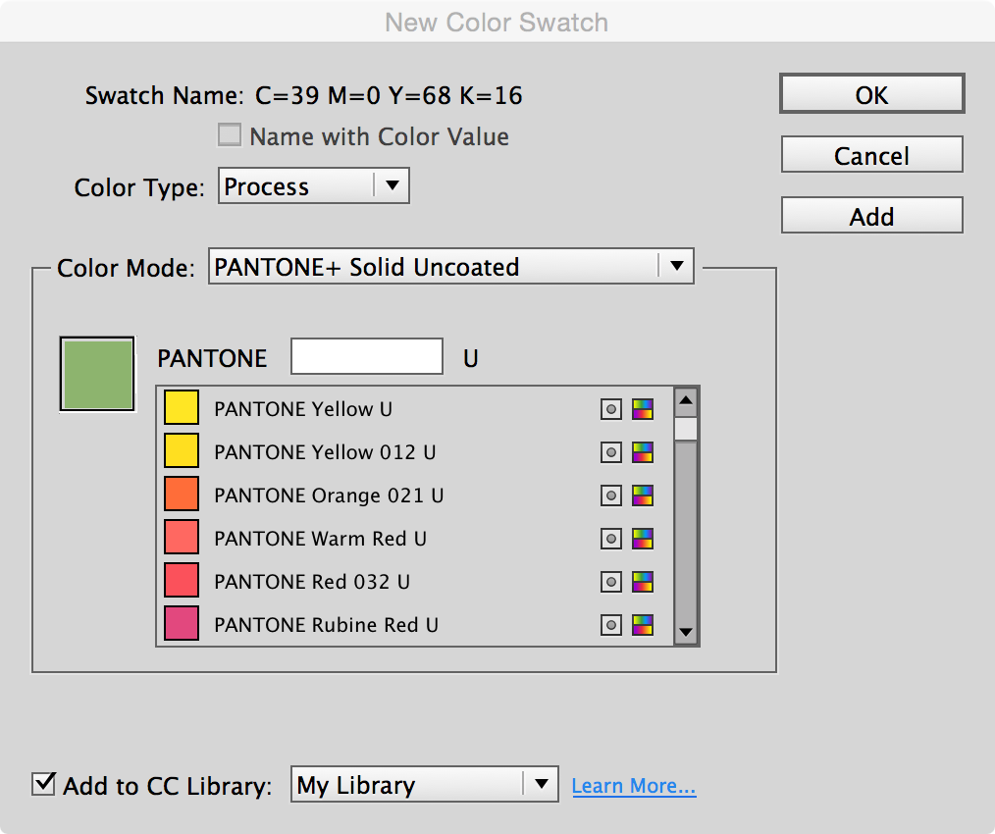
Add Color Swatches
Create a new color
Choose the New Color option in the Swatches Panel menu.
Adjust CMYK sliders for desired color.
Use a color library
Choose New Color option.
In Color Mode, choose a color library.
Select desired color.

Slide 7
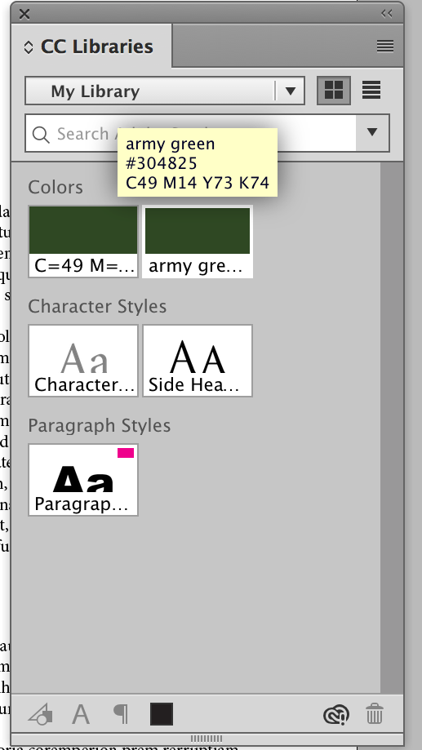
CC Libraries
Some features such as styles and new colors are applied to the current document only.
To access these features in other documents you may retrieve them from the CC Libraries Panel.

Slide 8
Effects
Effects include:
Drop Shadow
Glow
Bevel and Emboss
Are applied to the OBJECT such as:
Shapes
Text block
Graphics

Slide 9
Table of Contents & Index
Table of Contents can automatically be created based on styles applied to headings and subheadings in document.
Index can be created by placing index markers with each word that should appear in the index. They will be listed in alphabetical order along with the page number.

Slide 10
Portable Document Format (PDF)
A universal file format that preserves the fonts, images, and layout of source documents created on a wide range of applications and platforms.
Anyone, anywhere can open a PDF. All you need is the free Adobe Reader software.
PDFs are compact and fully searchable.
Can preserve navigation elements such as table of contents and index entries, and interactivity features such as hyperlinks, bookmarks, media clips, and buttons

Slide 11
Interactive Documents
Creating interactive documents, presentations, and prototypes in InDesign gives designers the control over format and typography they demand, in the application with which they’re most familiar, but with enhancements like slide shows, button navigation, video, live hyperlinks, and more.
Can be exported as an interactive PDF.

Slide 12
Interactive Features
Animate objects using built-in animation presets and your own customized settings.
Modify or create motion paths.
Build slide shows or change a frame’s content using multistate objects.
Create buttons with normal, rollover, and click appearances.
Establish page transitions when the user proceeds from spread to spread.

Slide 13
Interactive Features
Import and preview rich media files including FLV video and MP3 audio, among other formats.
Assign actions to buttons that provide document navigation; play/pause/stop an animation, sound, or video; launch an external web page in the user’s browser; and more .
Preview all interactivity and rich media before exporting or publishing.

