Slide 1
Objective 202.01 3% Understand project management concepts used to create digital media.

Slide 2
Project Management
Beginning a digital media project from scratch and carrying it through to its final completion takes a unified effort from all parties involved.
Creating a Project Plan helps the process move forward quickly and efficiently. It helps the team avoid:
mistakes
arguments
tension within the team
wasted time

Slide 3
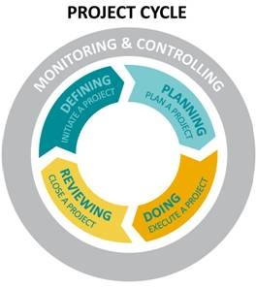
Project Management
Four stages in project management process:
Defining
Planning
Doing
Reviewing
Notes:
http://pmief.org/learning-resources/resources-for-youth/teachers/project-management-toolkit-for-teachers?tab=Framework

Slide 4
Project Management
Defining
Defining a project is the opportunity to establish its elements and boundaries, so that the size and shape of the project and its outcomes are all understood and agreed upon before beginning work.

Slide 5
Project Management
Planning
Planning is an important step because the amount of time and energy dedicated to planning will correlate directly to how well the project stays on schedule, on budget, and how well it meets its goals.

Slide 6
Project Management
Doing
The core of the project is the execution—the implementation of the plans. In order to accomplish their goals, members will be monitoring their work, collaborating with team members, assessing their progress, and revising their project plans as necessary.

Slide 7
Project Management
Reviewing
Reviewing is the opportunity to focus on the effectiveness of the team’s processes and the quality of the project deliverables. In this final stage, the focus is on assessing and celebrating the achievements of the entire project.

Slide 8
Defining: Project Plan/Project Scope
Some of the questions addressed include:
What do you do first?
What should come next?
Who will complete each task?
What resources do you need?
How long will it take?
When will the project be finished?
How will we know we are done with the project?

Slide 9
Defining: Project Plan/Project Scope
Identify the following things:
Project objectives
Target audience
Goals
Sub-phases
Tasks
Resources
Budget
Schedule
Notes:
http://www.cio.com.au/article/401353/how_define_scope_project/

Slide 10
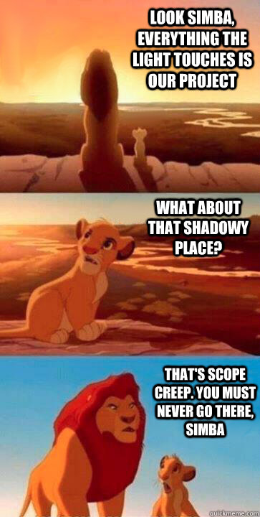
Defining: Project Plan/Project Scope
Scope Creep
Incremental expansion of the project scope.
Introducing features not originally planned.
Delays project and adds cost.
Notes:
http://www.cio.com.au/article/401353/how_define_scope_project/

Slide 11
Defining: Flow Chart
Objective ____ or Task ____
Write Materials on the sides.
Steps to complete

Slide 12
Defining: Schedule

Slide 13
Planning
File requirements
File management
Color scheme
Typography
Logos/images created or located
Script/Storyboard/Mock Layout created

Slide 14
Doing
Create needed project elements
Compile and edit project
Monitor schedule and task completion

Slide 15
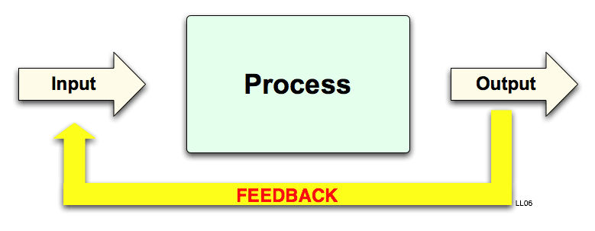
Reviewing
Preview proofs
Revise based on feedback
Optimize files
Publish in final format

Slide 16
Project Management
Four stages in project management process:
Defining
Planning
Doing
Reviewing
Notes:
http://pmief.org/learning-resources/resources-for-youth/teachers/project-management-toolkit-for-teachers?tab=Framework

