Slide 1
Objective 201.01 2% Understand career planning in a digital media environment.

Slide 2
Careers in Digital Media
Skills and knowledge in the digital media field can be applied to a wide variety of career fields. Careers may require skills from several areas of digital media, but are commonly divided into these fields:
Graphics
Animation
Audio Production
Video Production
Web Design

Slide 3
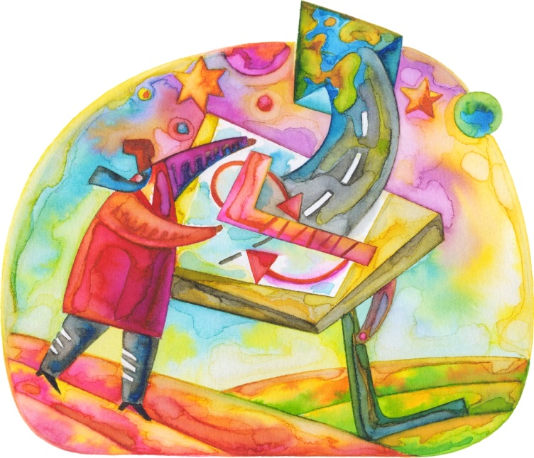
Careers in Graphics Field
Graphics Designer
The graphics designer is a specialist in visual arts, typography, page layout, user interface design, and print work. A wide variety of industries have a need for quality graphic designers.

Slide 4
Careers in Graphics Field
Art Director
The art director is the leader of interpretive art in advertising and marketing. They translate messages, concepts, and ideas into imagery for a variety of purposes.

Slide 5
Careers in Graphics Field
Photographer
The photographer captures visual images for a wide range of creative, technical, and documentary purposes. They frequently use software to digitally enhance their images.

Slide 6
Careers in Graphics Field
Front-End Web Developer
The front-end web developer creates the visual components of a website. This includes the graphics, buttons, logos, and other components of a page that the user sees and interacts with.

Slide 7
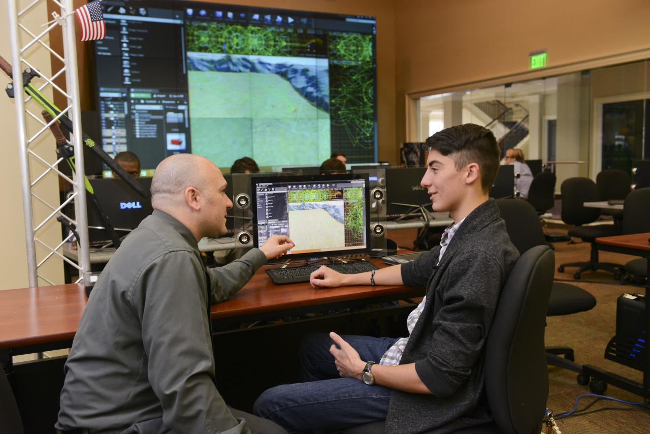
Careers in Animation Field
Video Game Designer
The video game designer creates and animates the characters, objects, and environments of a video game. They decide the gameplay, structures, and rules.

Slide 8
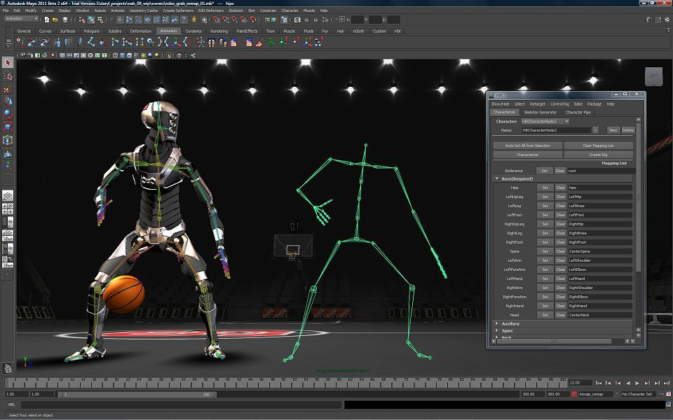
Careers in Animation Field
Character Animator
The character animator is specifically skilled at creating 2-D or 3-D characters and animating their realistic mechanics and interactions.

Slide 9
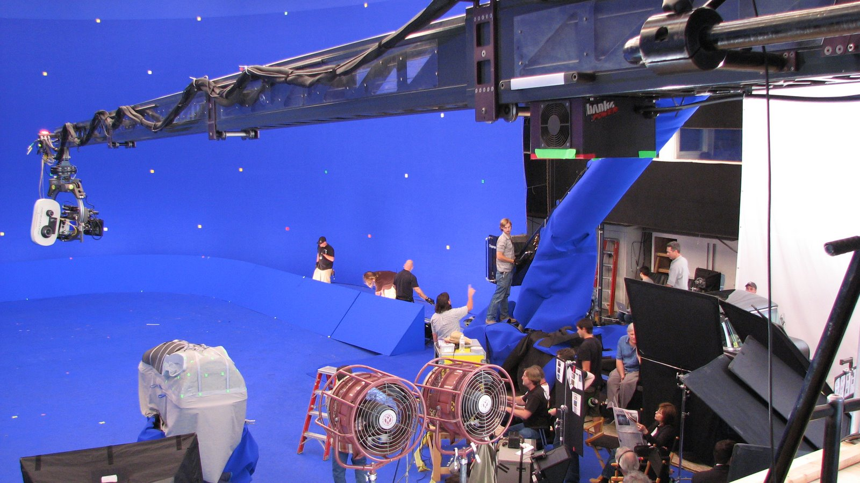
Careers in Animation Field
Special Effects Developer
The special effects developer creates realistic and imaginative scenes for theater, television, movies, and the internet.

Slide 10
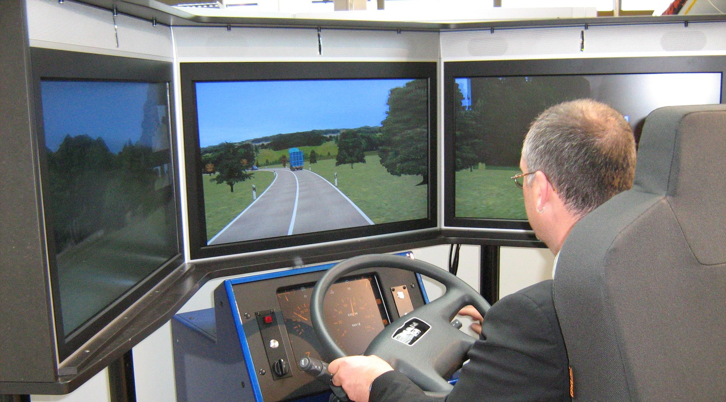
Careers in Animation Field
Simulation Creator
The simulation creator designs educational animations or simulations that are used to teach a process or interactively demonstrate a concept.

Slide 11
Careers in Audio Field
Audio Engineer/Sound Technician
The audio engineer/sound technician manages equipment and monitors levels during the actual recording process or live performance. They may also include setup process to ensure the best possible sound is captured.

Slide 12
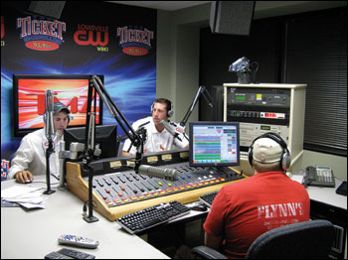
Careers in Audio Field
Radio
A career in radio includes positions required to produce a radio broadcast. These positions include, announcer, audio engineer, music director, program director, and many others.

Slide 13
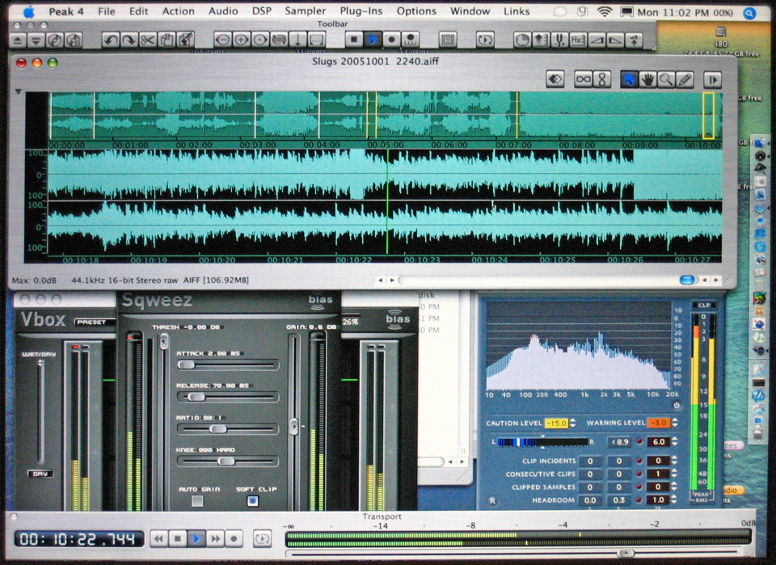
Careers in Audio Field
Audio Editor
The audio editor is responsible for cutting, splicing, mixing audio clips, and arranging them into a well-composed audio production to convey a message to the audience.

Slide 14
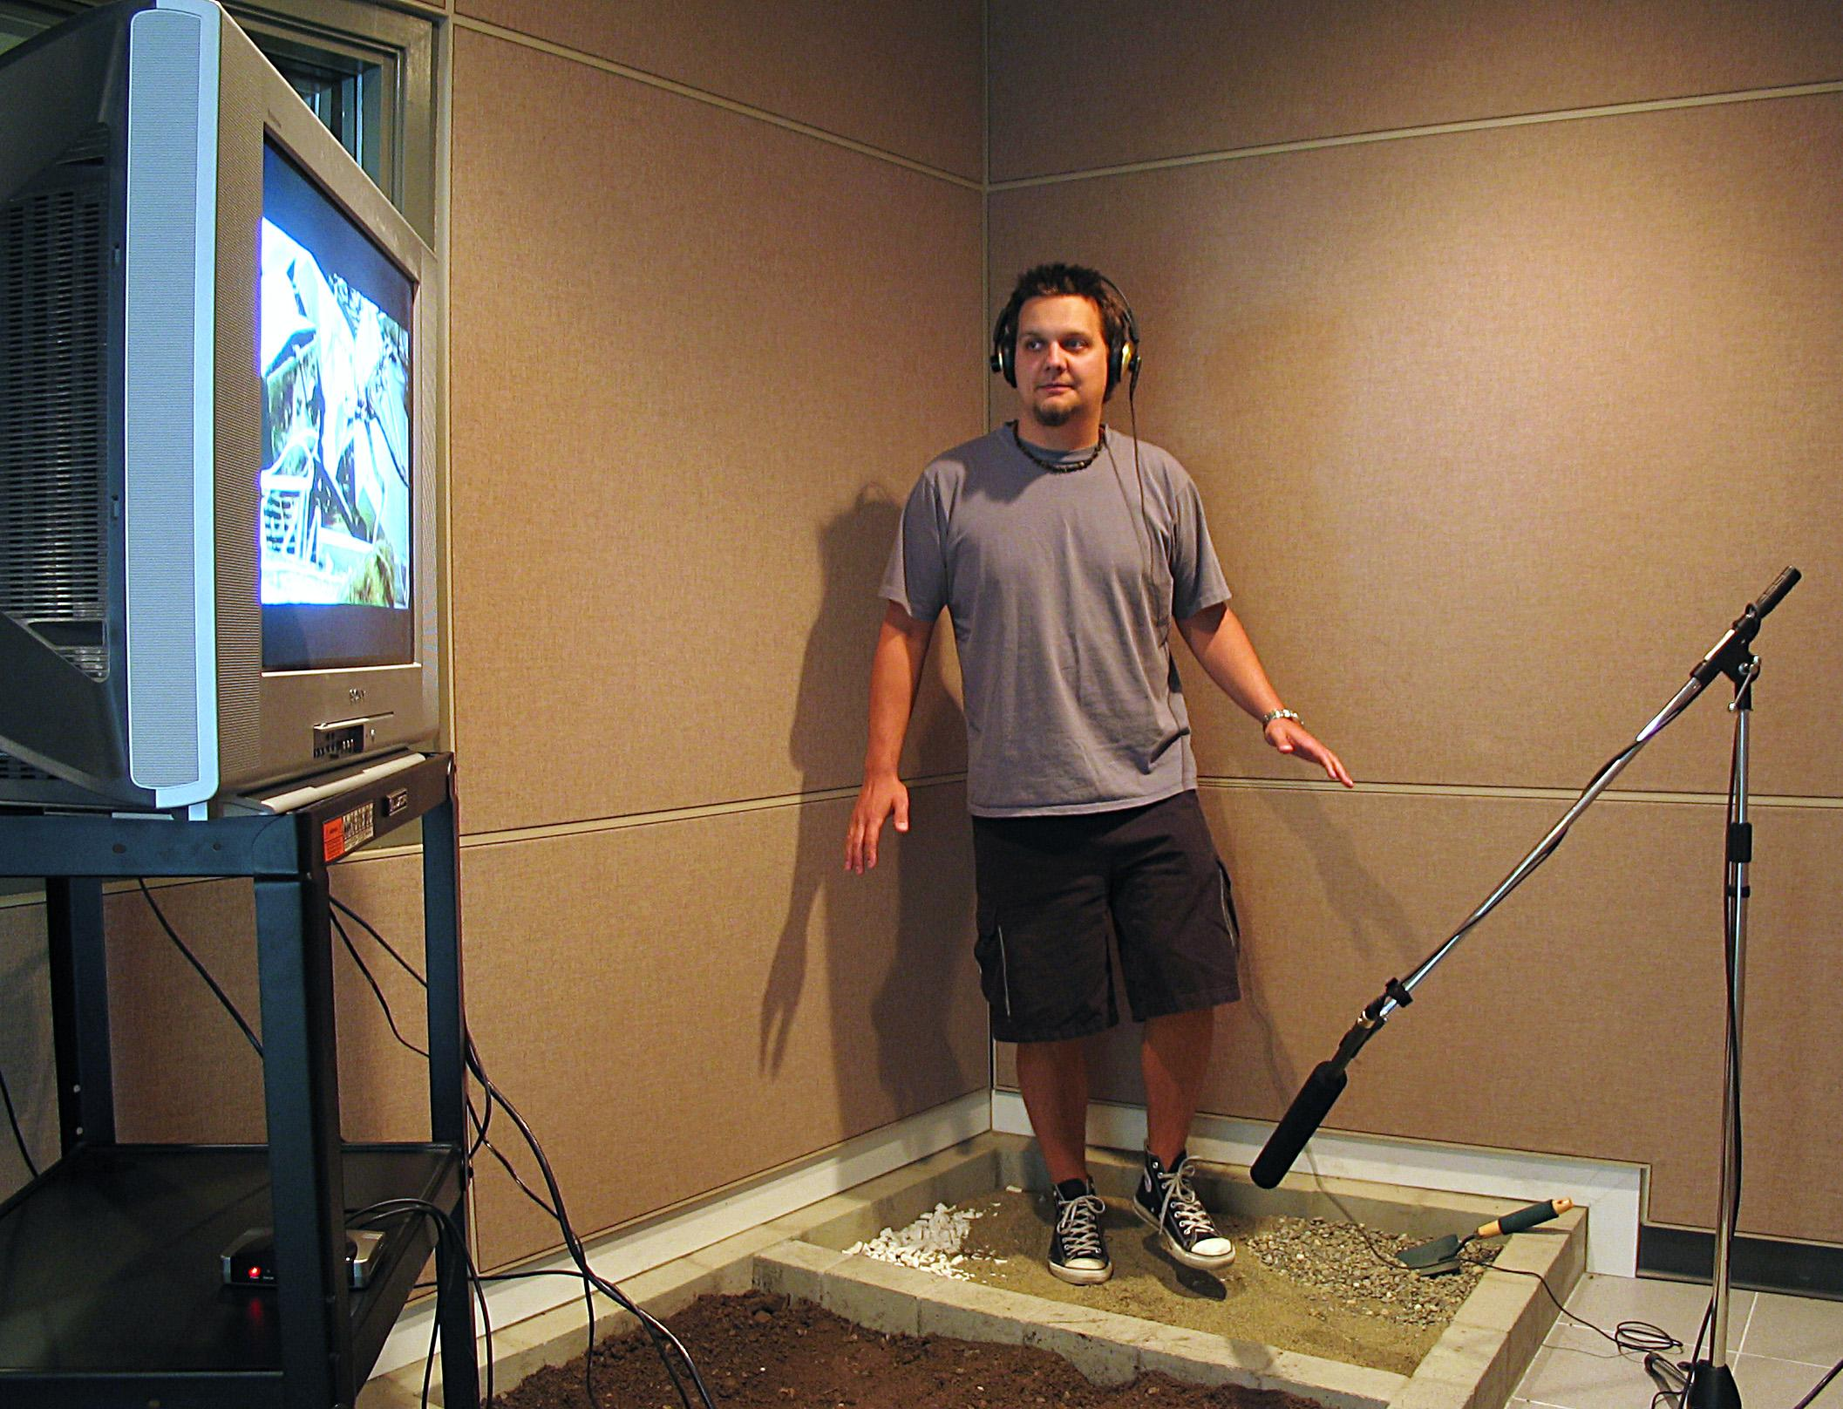
Careers in Audio Field
Foley Artist
The Foley artist re-creates the realistic ambient sounds that a movie or film portrays.

Slide 15
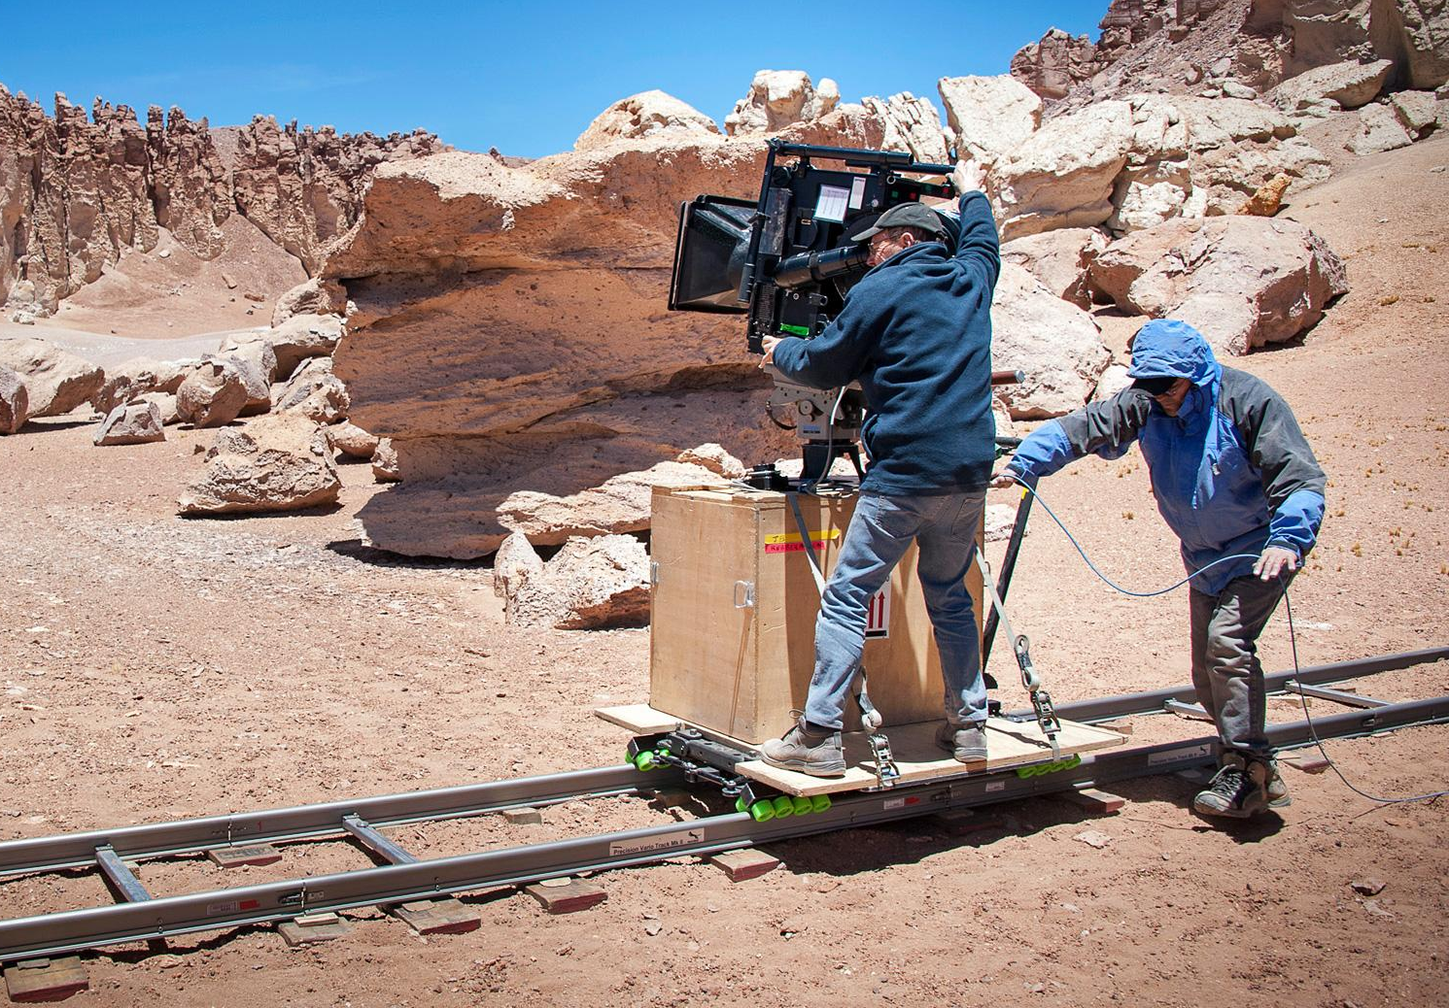
Careers in Video Field
Director/Technical Director
The director/technical director takes the project from the beginning of a script into full video production. They oversee camera angles, lighting, set design, and more.

Slide 16
Careers in Video Field
Camera Operator/Videographer
The camera operator or videographer, follows instructions from the director. Their job is to capture footage during the production of a video.

Slide 17
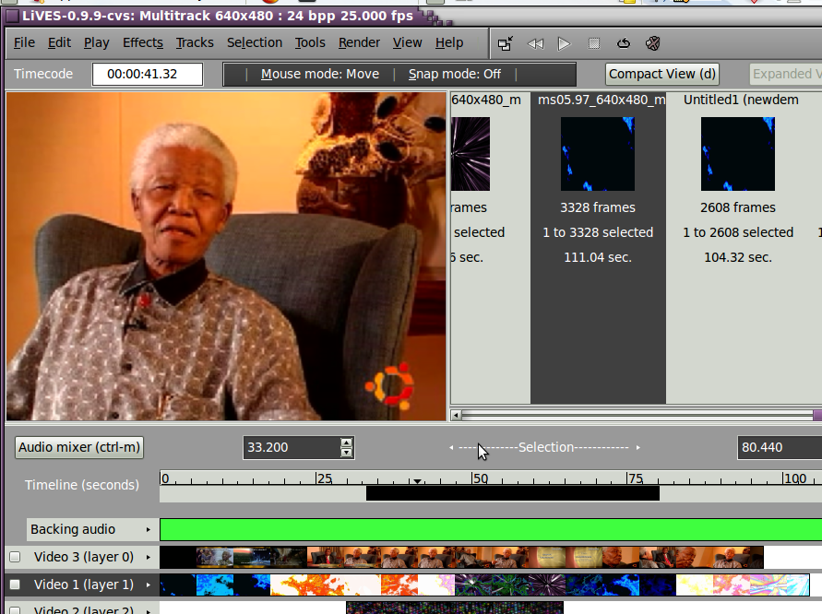
Careers in Video Field
Video Editor
The video editor manipulates the raw video footage and/or audio clips, and combines them into a sequence to create a final product.

Slide 18
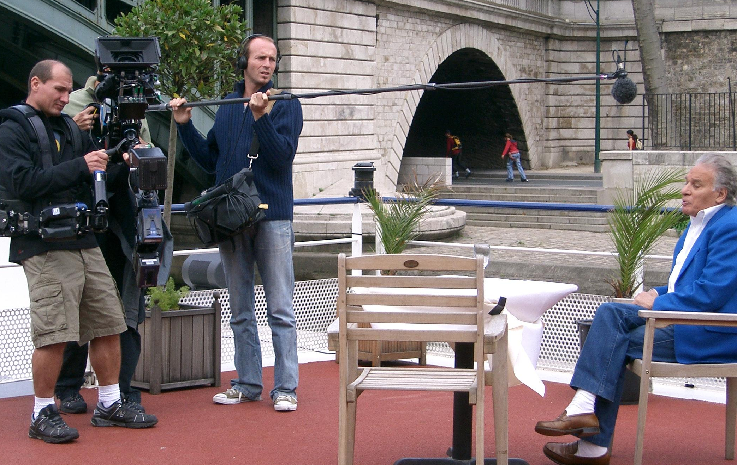
Careers in Video Field
Production Assistant
The production assistant is in charge of various aspects of production such as lighting (gaffer), cable management (grip), and many more.

Slide 19
Careers in Web Design Field
Web Designer
The web designer plans, designs, and maintains webpages on the internet. They write HTML or CSS code that makes websites work, allowing for user interaction.

Slide 20
Careers in Web Design Field
Programmer
The programmer is an expert in a variety of computer code languages. They also create software, standalone computer programs, and web pages.

Slide 21
Careers in Web Design Field
Mobile App Developer
The mobile app developer designs interactive experiences in a variety of mobile platforms using new and emerging technologies and code languages.

Slide 22
Careers in Web Design Field
Web Specialist
The web specialist is a developer that specializes in a particular field of web design (usability, accessibility, marketing, search engine optimization, page architecture, etc.).

Slide 23
What is Career Planning?
Career planning is the continuous process of:
Thinking about your interests, values, skills and preferences.
Exploring the life, work and learning options available to you.
Ensuring that your work fits with your personal circumstances.
Continuously fine-tuning your work and learning plans to help you manage the changes in your life and the world of work.

Slide 24
Career Planning Steps
Begin by thinking about where you are now, where you want to be and how you’re going to get there.
Explore the occupations and learning areas that interest you and research the specific skills and qualifications required for those occupations.
Compare your options, narrowing down your choices and thinking about what suits you best at this point in time.
Use the information you have gathered about your interests and the world of work to create your plan
Notes:
http://www.careercentre.dtwd.wa.gov.au/CareerPlanning/Pages/CareerPlanning-4StepPlanningProcess.aspx

