Slide 1
Objective 104.02 3% Describe digital audio production methods, software, and hardware.

Slide 2
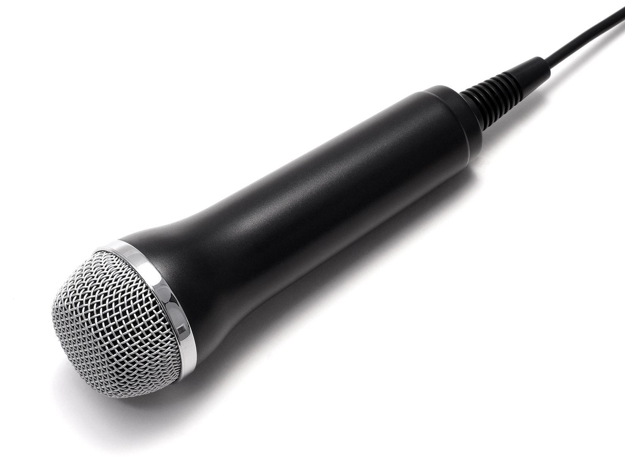
Pre-Production
Determine the overall purpose of the project.
Define the intended target audience.
Consult with the client and write a script that effectively conveys the intended message to the audience.
Determine hardware:
Microphones
Audio Recording Device
Determine software.

Slide 3
Audio Editing Software
Captures audio from the original source and imports it into the editing software (Example: Adobe Audition, Audacity).
Manipulates audio clips and adds the desired tracks and effects to convey the intended message.

Slide 4
Production
Record audio from original source.
Maintain audio levels throughout recording to ensure quality.
Save recorded audio.

Slide 5
Post-Production
Use an audio editing software to edit the recorded audio.
Optimize the audio output file for specific client needs, including:
Primary use of audio clip
File size requirements
File format requirements

Slide 6
Audio Recording Terms
Track
Separate layers of audio used to record sources individually.
Volume Units Meter
A visual representation of the audio volume level; used to ensure all audio clips recorded are at the same level.
Master Level
Used to control the overall output volume of an audio recording.

Slide 7
Audio Recording Terms
Audio Panning
When audio is recorded through separate channels (left or right).
Over-modulation
Sound interference that occurs during recording when audio levels are too high and causes the signal to distort or lose clarity.

Slide 8
Audio Editing Terms
Clip
A section of recorded sound used to create an audio production.
Trim/Splice
Starting and stopping audio clips at a defined point in the recording.
Adjusting Track Levels
Increasing or decreasing the volume of individual tracks to ensure all tracks are audible and blend well together.

Slide 9
Audio Editing Terms
Fade
Gradual change of volume used to change between clips of audio.
Fade Up (In) and Fade Down (Out)
Gradually increasing or decreasing the volume of an audio clip.
Crossfade
A gradual volume transition from one audio clip to another.

Slide 10
Audio Editing Terms
Loop
Used to make a section of audio repeat.
Audio Effects
Adjustments to clips used to change the original sound in order to reach the desired outcome.
Background Audio
Music and/or sounds used to add interest and depth to an audio production.
Voiceover
Voice used to convey a message to the audience.

