Slide 1
Objective 103.02 4% Describe digital animation production methods, software, and hardware.

Slide 2
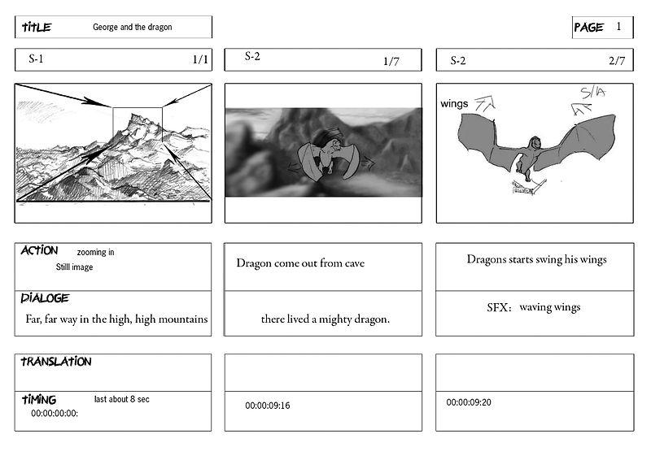
Pre-Production
Determine the overall purpose of the project.
Define the intended target audience.
Use a storyboard to determine sequence of events and provide client with a visual representation of ideas.
Select hardware.
Select software.

Slide 3
Animation Software
2D Animation
Animates relatively simple drawings or graphics on a 2D canvas (Example: Adobe Flash or Animate).
3D Animation
Animates complex, life-like 3D models that interact with an artificial environment (Example: Cinema4D, 3D Studio Max, or Maya).

Slide 4
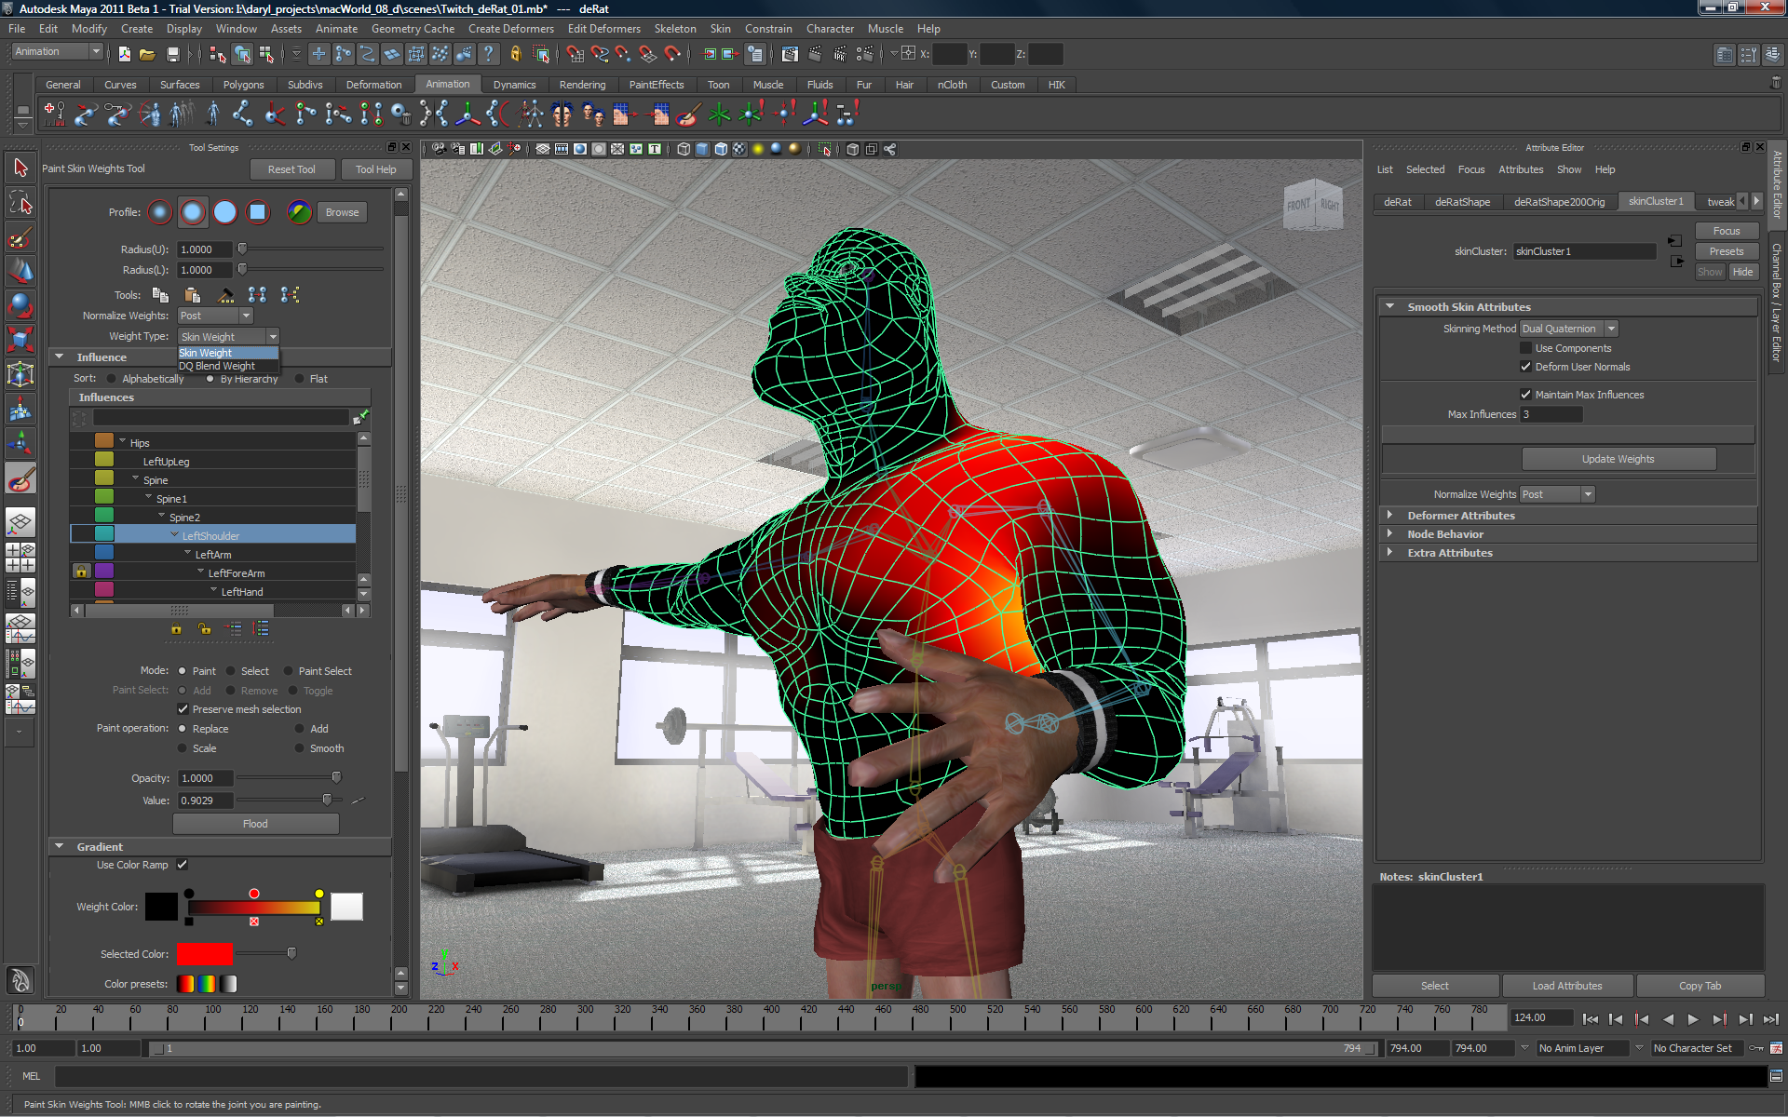
Production
Import existing graphics, audio and/or video into library of animation project.
Draw or create original graphics and place them on independent layers.
Animate the objects according to the storyboard.

Slide 5
Stop Motion Production
Scene
Create a scene and/or backgrounds with which the figurines or graphics can interact.
Figurines/Graphics
Make the figurines and/or graphics to be used in the animation.
Lighting/Camera Setup
Light the scene and set up the camera on a tripod to capture each frame.

Slide 6
Post-Production
Optimize the animation output file for specific client needs, including:
Primary use of animation
File size requirements
File format requirements

Slide 7
Animation Editing Terms
Frame
Still image that creates animation when viewed in succession.
Keyframe
Specified place in the animation where change occurs.
Frames Per Second (FPS)
Measurement of playback speed of an animation.

Slide 8
Animation Editing Terms
Tween
Animation process that occurs between keyframes.
Motion Tween
Used to make an object smoothly transition from a defined starting position to a defined ending position.
Shape Tween
Used to make an object gradually morph or change shape.

Slide 9
Animation Editing Terms
Library
Collection of graphics, audio, and video files utilized in a particular animation project.
Symbol
An object stored in the library of a project that can be quickly accessed and used repeatedly throughout the animation.
Shape
A simple object drawn on the stage of an animation.

Slide 10
Animation Editing Terms
Alpha
Transparency value of object in animation; normally used to make an object gradually fade in or fade out.
Anchor Point
Rotation axis of an animated spinning object.
Scene
A division of frames used to separate different parts of an animation to make editing and playback easier to organize.

