Slide 1
Objective 102.01 15% Explain design concepts used to create digital graphics.

Slide 2
Part 1: Elements of Design
Color
Line
Shape
Texture

Slide 3
Color
Helps identify objects in a design.
Creates visual flow in a design.
Communicates feelings and moods to the audience or viewer.
Consists of hue, saturation, and brightness.

Slide 4
Color
Particular colors in a design can communicate certain moods and feelings to the audience
RED - excitement, anger,
danger, love
ORANGE - liveliness, energy
warmth
BLUE - calm, sadness,
serenity
PURPLE - royalty, dignity
mystery
GREEN - envy, luck,
peacefulness
BLACK - mourning, despair
sophistication
YELLOW - cowardice, sympathy
cheerfulness
WHITE - innocence, purity,
faith

Slide 5
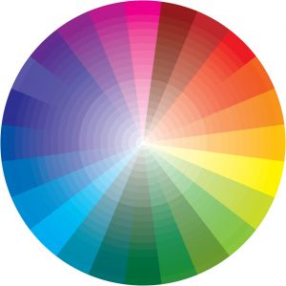
Complementary Colors
Colors across from each other on the color wheel work well together when used in a design
Example : Purple and Green

Slide 6
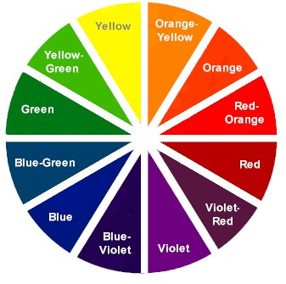
Hue
The name given to a color
Within a particular hue, a variety of individual colors can be created by changing saturation and brightness

Slide 7
Saturation
The amount of hue used in a particular color.
Example : PURPLE
Less saturated with the purple hue.
More saturated with the purple hue.

Slide 8
Brightness
How light or dark a color appears; adding black or white changes a color’s brightness.
Example : GREEN
Bright Green (white added to a green hue).
Dark Green (black added to green hue).

Slide 9
Lines
Give direction to a design.
Create movement in a design.
Thick lines show importance, thin lines demonstrate quick movement.
Could be vertical, horizontal, diagonal, or curved lines.

Slide 10
Lines
VERTICAL LINES
-carry eye up and down
-convey a feeling of awe
or challenge
DIAGONAL LINES
-slanted
-add interest to a design
HORIZONTAL LINES
-carry eye left and right
-convey a feeling of calm or peacefulness
CURVED LINES
-gently bent
-give a soft, relaxed
feel to a design

Slide 11
Shape
The form of an object.
When lines enclose a space.
Can be used to help identify objects:
Example : circle = sun, oval = egg
Three basic shape types:

Slide 12
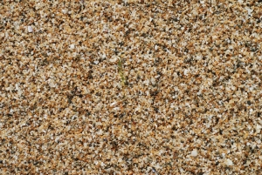
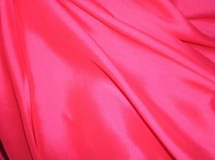
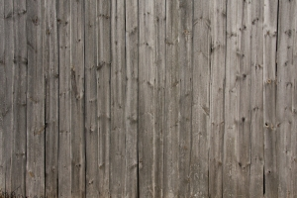
Texture
Combination of dots, lines, and colors used create the illusion of a surface appearance.
Adds depth and dimension to a design.

Slide 13
Part 2: Principles of Design
Proportion
Balance
Rhythm
Emphasis
Unity/Harmony

Slide 14
Proportion
A size relationship between components of a design.
Proportion can be:
Between one component of a design and another component .
OR
Between a component and the design as a whole.

Slide 15
Balance
How design elements are arranged either horizontally or vertically on the canvas.
FORMAL BALANCE
Also known as symmetrical balance
Design is exactly equal on both sides
INFORMAL BALANCE
Also known as asymmetrical balance
Both sides of the design are not equal, but are still balanced

Slide 16
Rhythm
Creating the feeling of movement in a design.
Generated through the repetition of lines, colors, shapes, and textures.

Slide 17
Emphasis
Center of interest in a design.
Component of the design that is noticed first by the audience.
Can create visual flow in a design.

Slide 18
Unity/Harmony
When all components of a design look as if they belong together.
Achieved when the Elements and Principles of Design are used effectively.

Slide 19
Part 3 Digital Graphics
Any image or design created or edited by a computer.
Drawings
Logos
Photos
Advertising
Buttons
Icons
Diagrams
Charts

Slide 20
Digital Graphics
Bitmap Graphics
Use square pixels arranged in a grid that have assigned colors.
Lose clarity when viewed up close or zoomed in.
Also referred to as Raster Graphics.
Vector Graphics
Use mathematical formulas to define lines, points, curves, and other attributes.
Do not lose clarity when viewed up close or zoomed in.
Best type of graphic for printing in large scale.

Slide 21
Resolution
Describes the clarity of Bitmap Graphics.
Determined and defined by the number of Pixels Per Inch (PPI).
LOW RESOLUTION
Blurry in appearance
Relatively small file size
HIGH RESOLUTION
Very clear in appearance
Relatively large file size

Slide 22
Color Modes of Digital Graphics
Black & White - uses only true black and true white.
Grayscale - uses true black, true white, and all shades of gray in between.
True Color - all possible color combinations.
RGB (Red, Green, Blue) - optimized for viewing on a screen.
CMYK (Cyan, Yellow, Magenta, Black) - optimized for printing purposes.

Slide 23
Color Depth
The number of distinct colors a graphic is capable of displaying.
Related to color mode:
1-Bit : Black & White
8-Bit : Indexed Color (256 colors)
24-Bit : True Color (16.7 million colors)

