Slide 1
Objective 207.01 4% Understand advanced production methods to design and develop websites.

Slide 2
Pre-Production
Meet with the client to create a project plan:
Determine the purpose of the website.
Define a target audience.
Set overall goals of the web site.
Agree on deadlines for phases of the project.
Create a budget.
Decide which web design language will best fit the needs of the website.

Slide 3
Pre-Production
Choose a set of typography based on client’s current marketing and branding materials.
A limited selection of fonts is available for web design, since downloaded fonts will not show properly on other users’ machines.
Choose fonts that are more likely to have consistency across platforms and browsers.

Slide 4
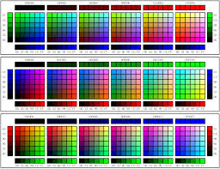
Pre-Production
Decide upon a color scheme that represents the client or company.
In web design, web safe colors are noted by hexadecimal value (hex code). For Example:
#496133
#1B6699
#3A3B76

Slide 5
Pre-Production
Work with client to create a flowchart.
Helps decide how many individual pages the website will contain and their titles.
Organizes the structure and navigation between parent pages and child pages.

Slide 6
Pre-Production
Gather and manage digital assets.
Create a file-naming convention to assure proper organization and storage.
Save and organize files for easy and quick access. In web design this is often done in the root folder.
For web design, knowing a file’s pathname is very important.
Links to a file on a website call on the pathname of the file, not the file itself
User/Desktop/WebDesign/Assets/HomeBanner.jpg

Slide 7
Pre-Production
Determine specific software needs:
Visual Editor
Design software that manipulates components of the web page without the user writing or editing code, WYSIWYG (What You See Is What You Get).
Text Editor
Simple text editing program used to write or edit web design code; does not show a visual component.

Slide 8
Production
Create web page template.
Set up formatting rules.
Add content, graphics, text, and hyperlinks.
Set up site navigation.

Slide 9
Post-Production
Review design comps with client:
Provide the client with multiple renditions of the website that meet the goals and purpose, but look visually different (layout, colors, etc.).
Used for comparison purposes so the client can make a final decision.
Different layouts could be used for different pages of the website (landing page, home page, contact page, etc.).

Slide 10
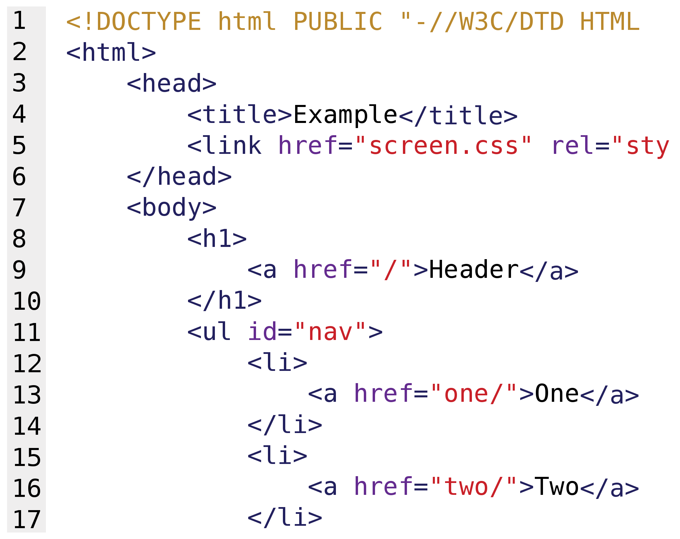
Post-Production
Debug the source code
Run the website’s code through a debug program to check for syntax or structure errors.

Slide 11
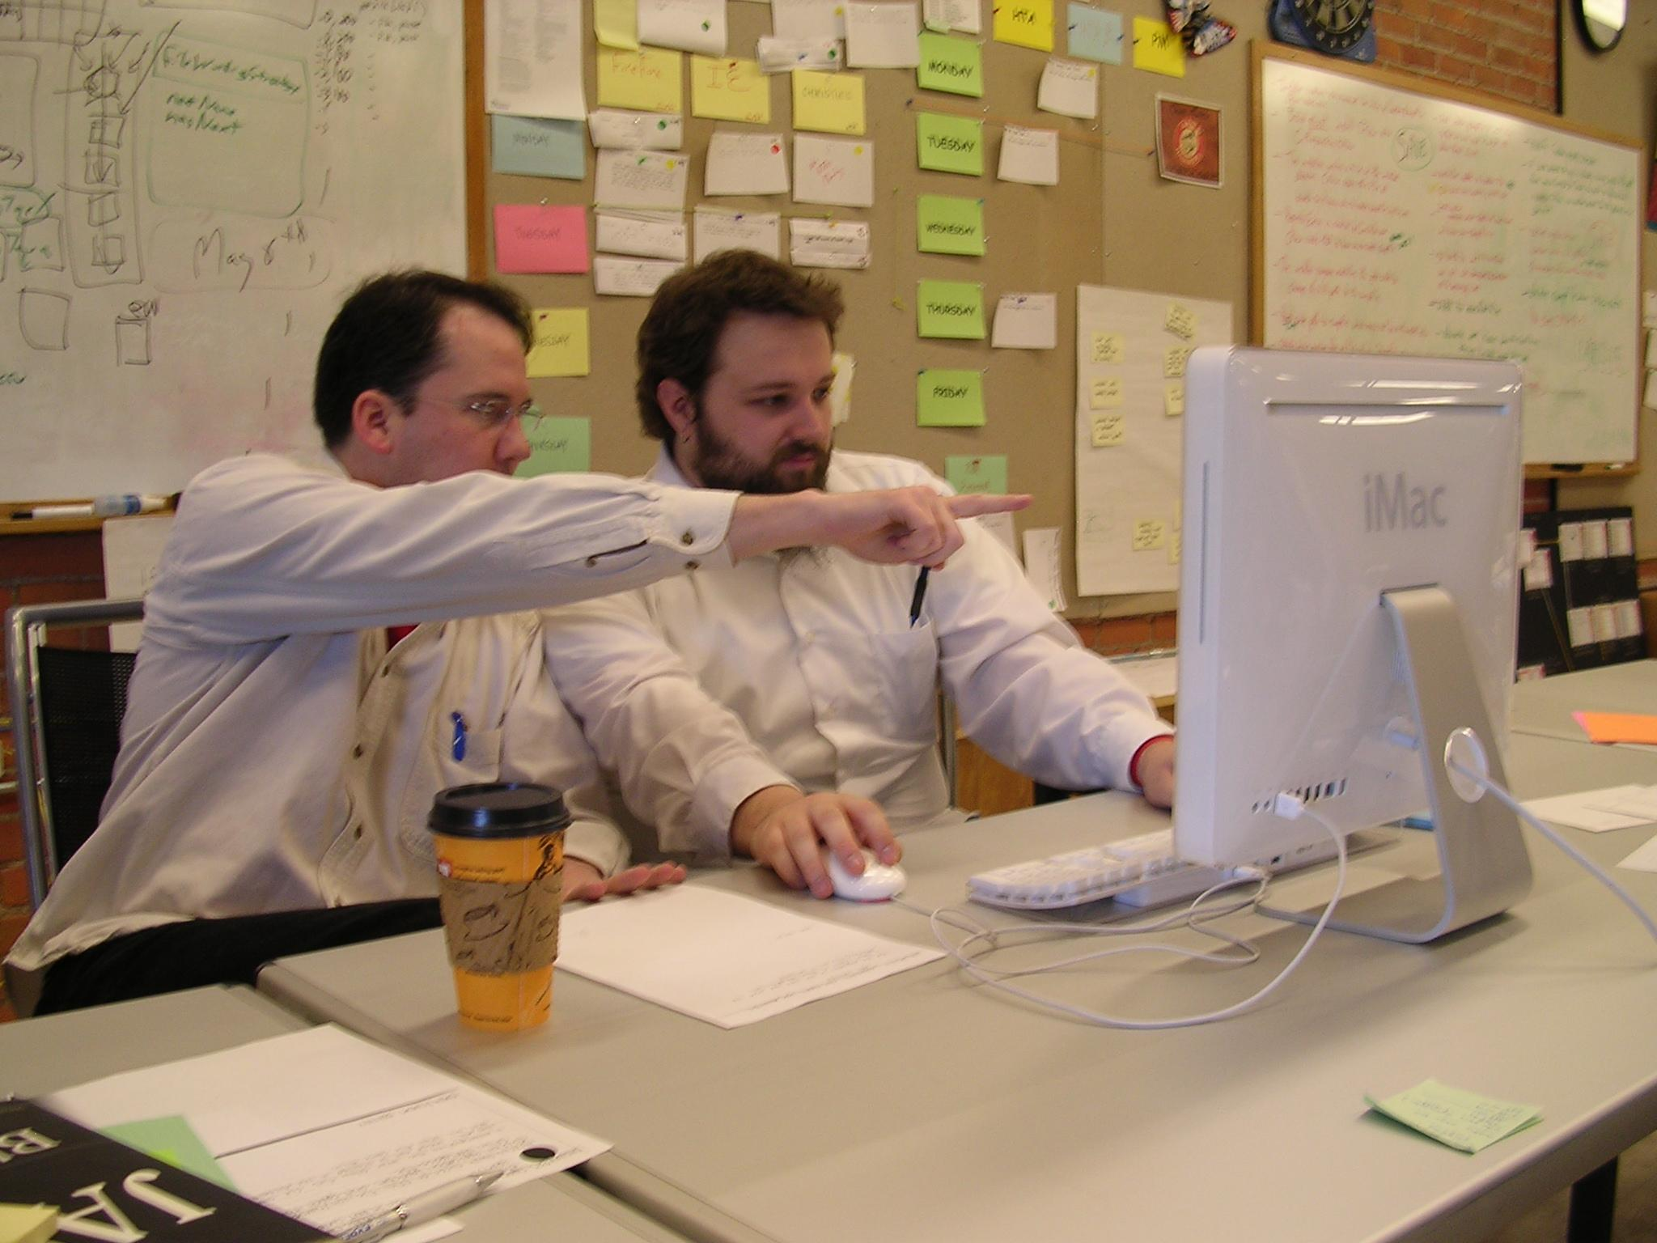
Post-Production
Preview the final version
Proofread the website for errors in text.
Check the links to make sure they are all working.
Check the website for compatibility with all browsers to ensure consistency.

Slide 12
Post-Production
Publish the final website:
Save all of the CSS and HTML files, images, and other assets (on the designer’s computer and/or on an external server if necessary).
Publish the website to the Internet (through a website hosting site or through the client’s home server).

