Slide 1
Objective 205.03 5% Execute advanced production methods to create digital audio.

Slide 2
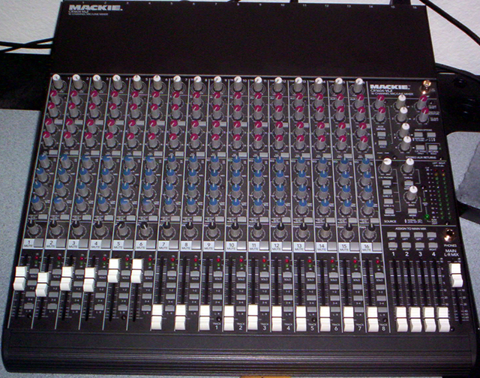
Live Audio Techniques
When working with live audio a mixing console is typically used.

Slide 3
Audio Input
Each microphone or audio input is connected to the mixer to be adjusted in a channel.
Guitar
Vocal
Drum
Bass

Slide 4
Channel Process
No matter how many channels an audio mixing board has, each channel works the same way.
The sound enters through the audio gain area.
The sound is edited with the EQ and the Aux section.
The volume control for the channel before it is mixed is the fader.
Audio Gain
Audio EQ
Aux Section
Channel Fader

Slide 5
Audio Adjustments
The gain controls how much audio is coming in, and the fader controls how much sound is coming out.
The gain should be set, then EQ and Aux adjusted for a proper sound.
To control the volume of that channel after Gain, EQ and Aux are set, only the fader should be used. Adjusting the gain will cause the EQ and Aux to be re-calibrated.
Audio Gain
Audio EQ
Aux Section
Channel Fader

Slide 6
Master Area
Once each channel is set, they all are fed into a master area.
From the master area; mixed sound goes to performers’ headsets, the mixer’s headphones, speakers and recording devices.

Slide 7
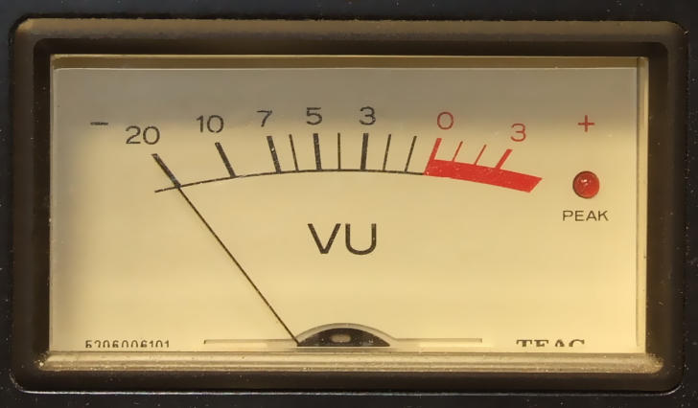
VU Meter
It is important to watch the VU meter in the master section of the mixing console.
If the volume goes into the red area often, or remains in the red area, there is the possibility of audio distortion.
Analog VU Meter
Digital VU Meter

Slide 8
Adobe Audition
The work area in Adobe Audition can be configured to simulate an analog mixer.
Instead of feeding live microphones in for each channel, Audition displays each recorded element on a channel.

Slide 9
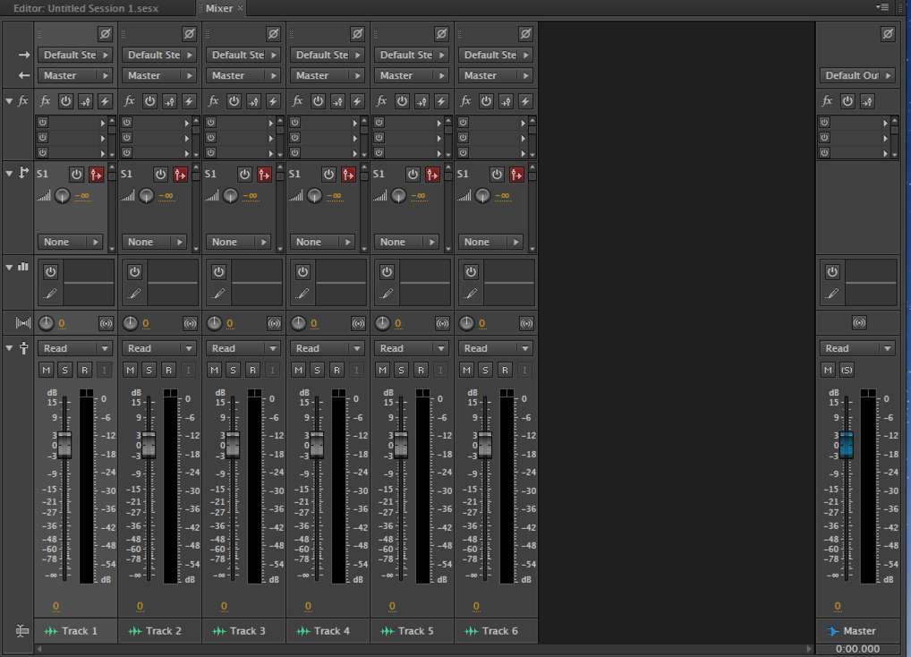
Adobe Audition

Slide 10
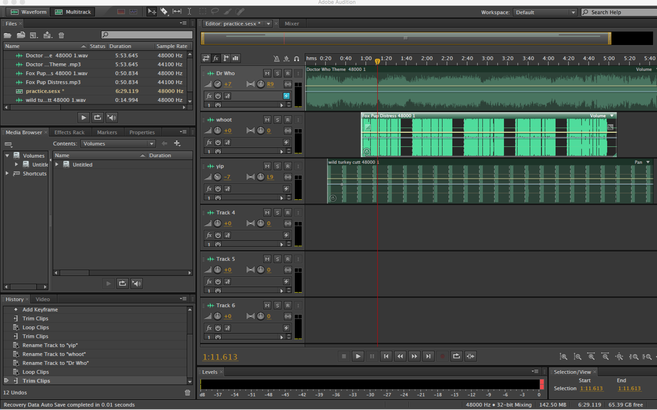
Linear Configuration
The file can also be set up in a linear configuration.

Slide 11
Files Bin
Audio files to work with are stored in the “Files” Bin.

Slide 12
Timeline Editor
Audio can be placed on the timeline editor to be trimmed, looped, faded in and out.

Slide 13
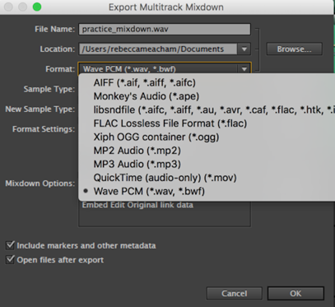
Exporting Audio
Audio can be exported in a variety of formats.

