Slide 1
Objective 205.02 5% Select and utilize tools for digital audio production.

Slide 2
Microphones
There are different types of microphones that have particular characteristics and produce different results.
Condenser
Dynamic
Lavaliere
Shotgun

Slide 3
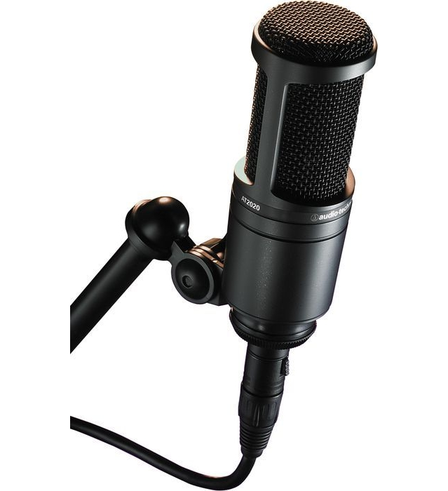
Condenser Microphone
Requires an outside power source (phantom power).
Results in a high quality signal production.
Commonly used to capture a person’s voice or a musical instrument in a studio.

Slide 4
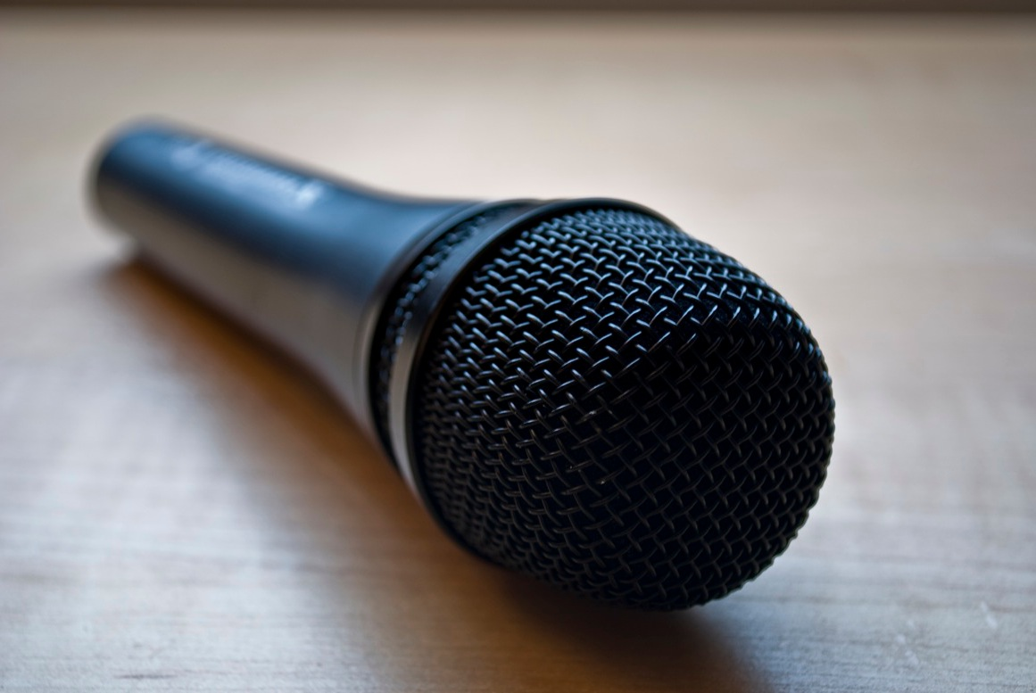
Dynamic Microphone
Does not require an outside power source.
Audio signal strengthened by an audio board or other amplifier.
Commonly used to capture audio during live production.
Durable microphone.

Slide 5
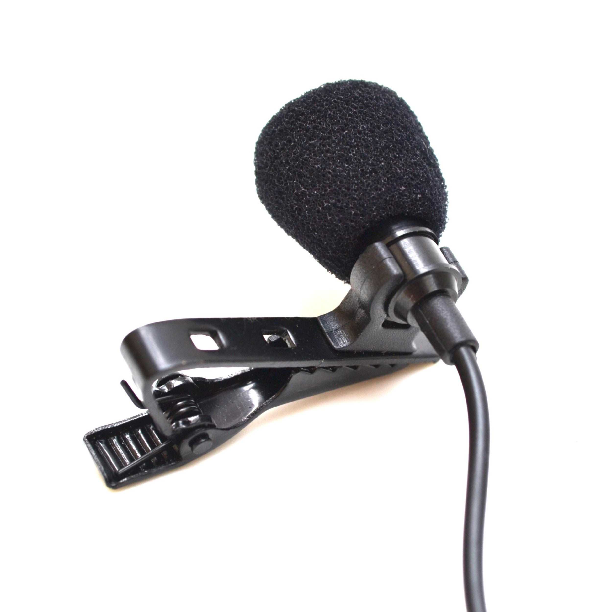
Lavaliere Microphone
Typically attached to the necktie or shirt of the user.
Used by performers on television or stage because their small size makes it easy to hide.
Produce a relatively good sound quality.

Slide 6
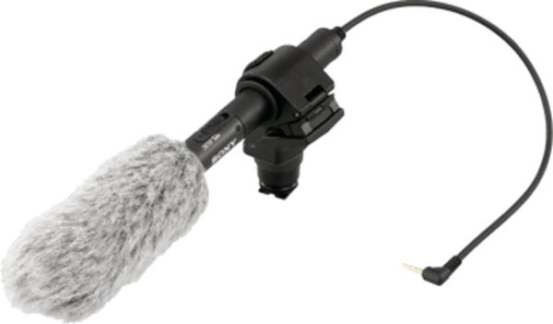
Shotgun Microphone
Usually long and skinny in appearance.
Commonly found on high-end video cameras for capturing sound from the recording.
Also referred to as a “boom” microphone.

Slide 7
Audio Cables
Certain cable types are needed to connect all of the equipment correctly.
RCA Cables
XLR Cables
Mini Cables
¼” (Phono) Cables

Slide 8
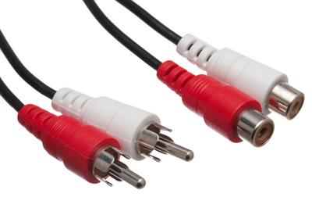
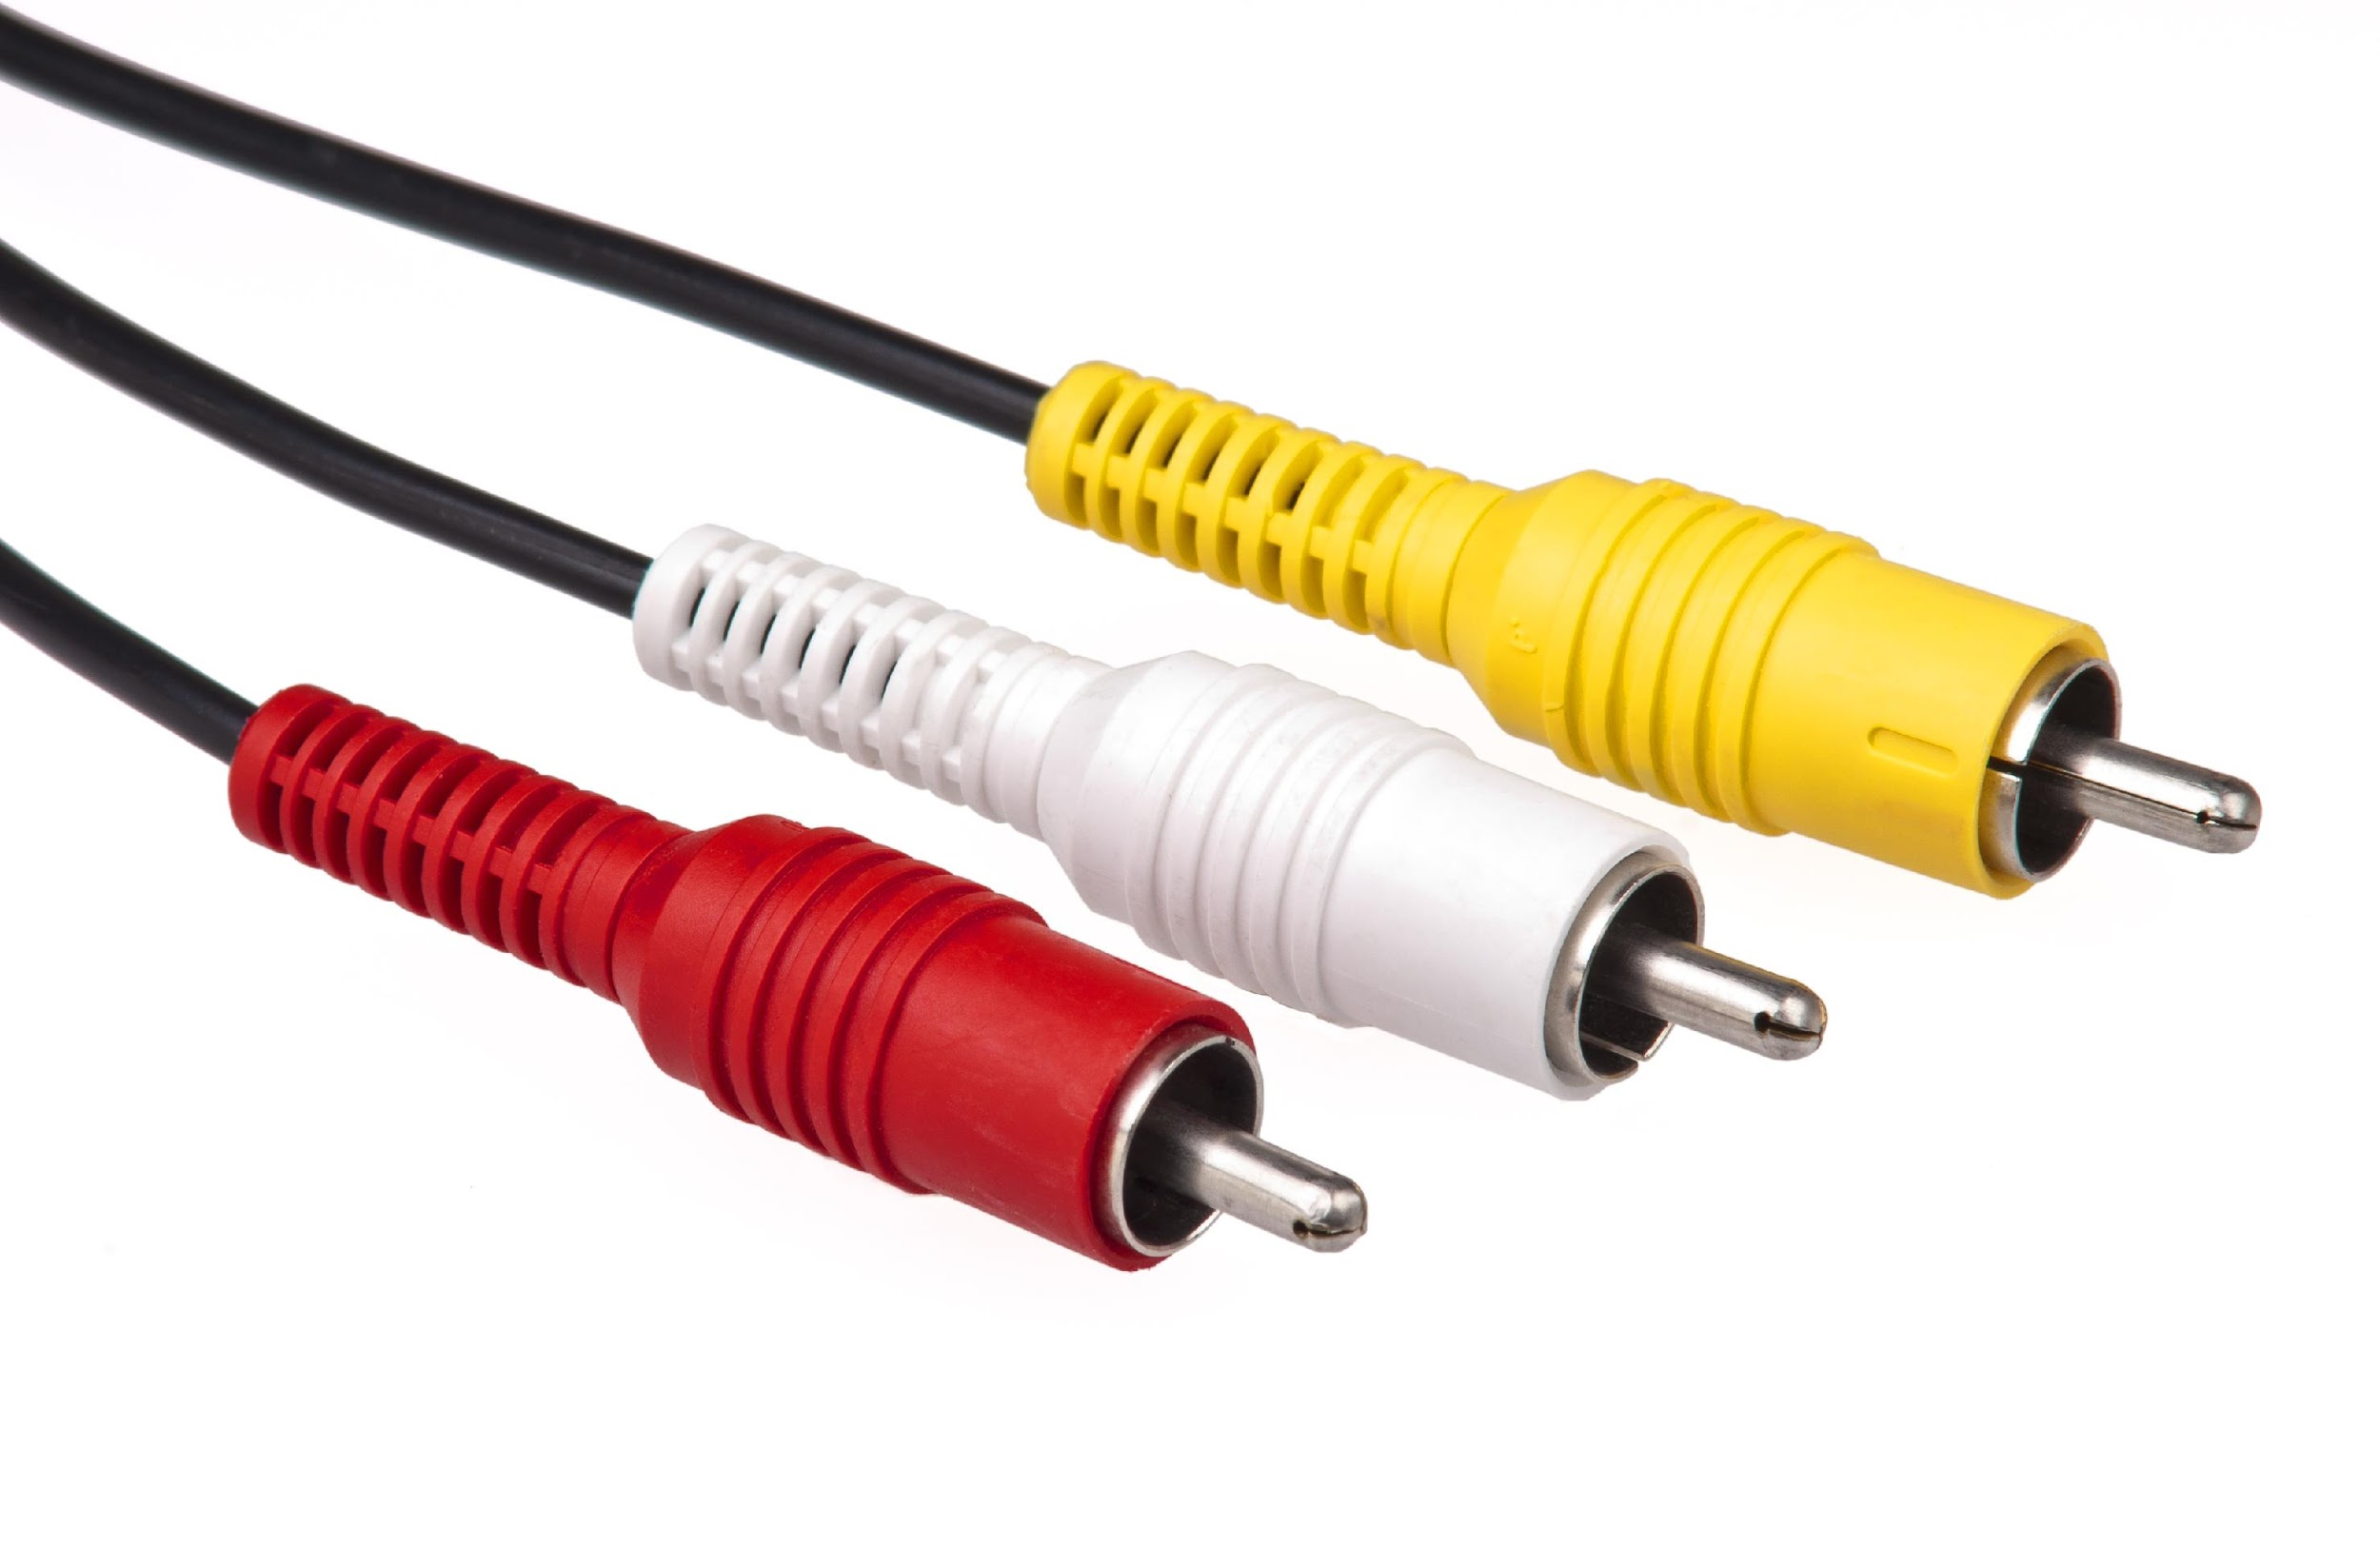
RCA Cables
Very common audio (and video) cable used in professional and consumer settings alike.
Color coded system makes it easy to distinguish left and right channels of audio.

Slide 9
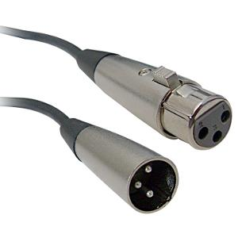
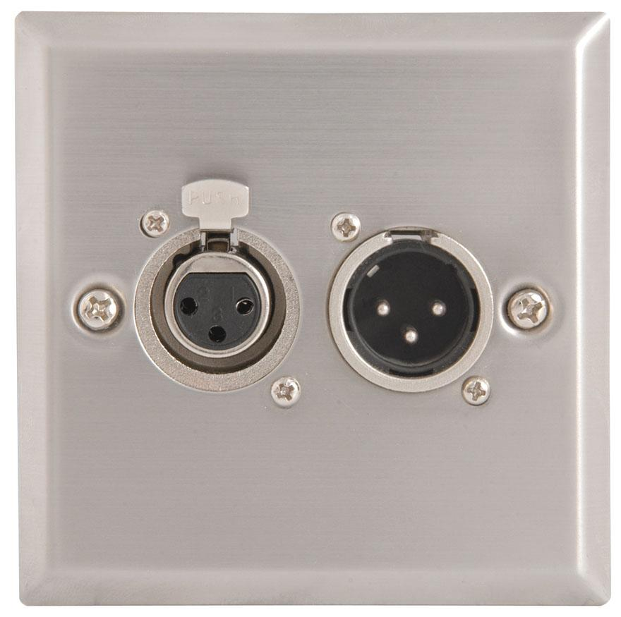
XLR Cables
The best audio quality, making it common in the professional industry.
Has a push-button locking system that keeps it from easily being unplugged.
Very commonly used for microphones.

Slide 10
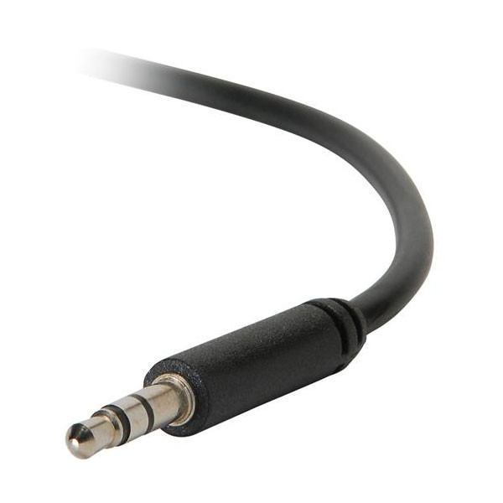
Mini Cables
Found on virtually every consumer audio device.
Relatively poor audio quality.
Number of rings around the plug indicate if cable is mono (one ring) or stereo (two rings).

Slide 11
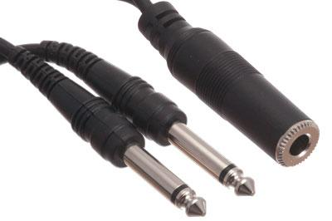
¼” (Phonos) Cables
Widely used to connect speakers, amplifiers, and guitars.
Similar to mini plug with the rings indicating the number of channels.
Better audio quality when compared to the mini.

Slide 12
Microphone Pickup Patterns
Depending on the type of recording that is desired and the location of the performers, different microphone pickup patterns record the sound in varying methods.

Slide 13
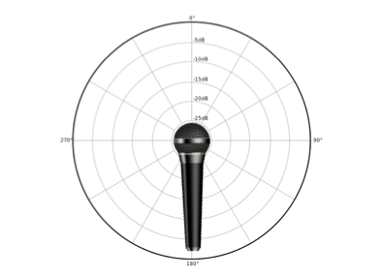
Microphone Pickup Patterns
Omnidirectional Pickup Pattern
Captures sound from all directions.
Useful for capturing sound from all parts of a room.
Commonly found on consumer video cameras.

Slide 14
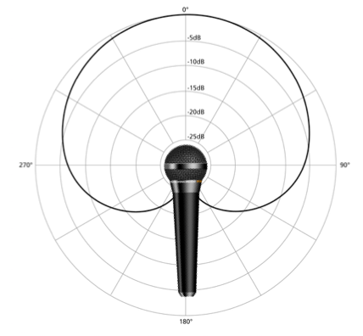
Microphone Pickup Patterns
Cardioid Pickup Pattern
Heart-shaped.
Audio sources in the front of the microphone and very close to the sides are captured.
Very little sound is picked up from behind the microphone.

Slide 15
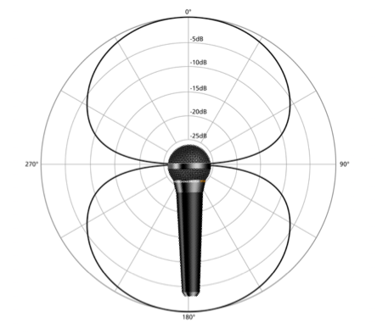
Microphone Pickup Patterns
Bi-Directional Pickup Pattern
Captures sound from in front of the microphone and behind it.
Very little sound is picked up from the sides.
Good microphone to use when recording a two-person conversation.

Slide 16
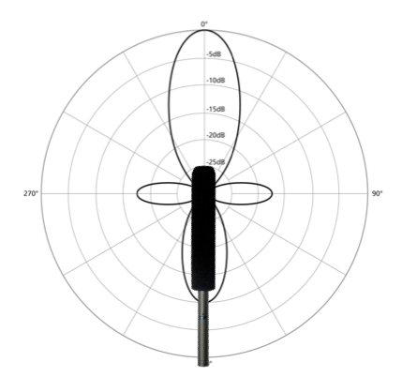
Microphone Pickup Patterns
Shotgun Pickup Pattern
Captures sound from a pointed direction in a narrow range.
Useful for recording sound from long distances away (during video shoots, in stadiums, recording wildlife, etc.).
Very little sound is picked up from the sides or behind the microphone.

Slide 17
Setup Microphone & Cables
Setup the microphone and use the appropriate cables to connect to a recording device
Monitor the levels of the audio while the recording is taking place.
Watch the V.U. meter to make sure the audio is at the appropriate level throughout the entire recording.
Adjust the volume of the recording to keep the signal from clipping (producing a signal that is too loud for the amplifier to handle).

Slide 18
Advanced Audio Editing Terms
Scrubbing
Clicking and dragging the playhead of an audio project through the timeline to get to a particular section.
The user is able to hear the audio while scrubbing, making navigation of the project more efficient.

Slide 19
Advanced Audio Editing Terms
Ducking
An editing feature that lowers the volume of a particular track when another audio source is present.
Commonly used for voiceovers with background music.
Equalization
The process of adjusting the different levels (bass, treble, mid-tones, etc.) in an audio recording in order to produce the best sound.

Slide 20
Advanced Audio Editing Terms
Audio Gain
Adding gain to audio will increase the level of the output signal using power from an amplifier; increases the voltage output of the signal.
Normalization
The process of making sure all of the audio levels in a project are at a consistent level and sound good together.

