Slide 1
Objective 105.02 5% Describe digital video production methods.

Slide 2
Pre-Production
Determine the overall purpose of the project.
Define the intended target audience.
Consult with the client to write a script that effectively conveys the intended message.
Create a storyboard to determine sequence of events and provide client with a visual representation of ideas.
Determine specific hardware needs.
Determine specific software needs.

Slide 3
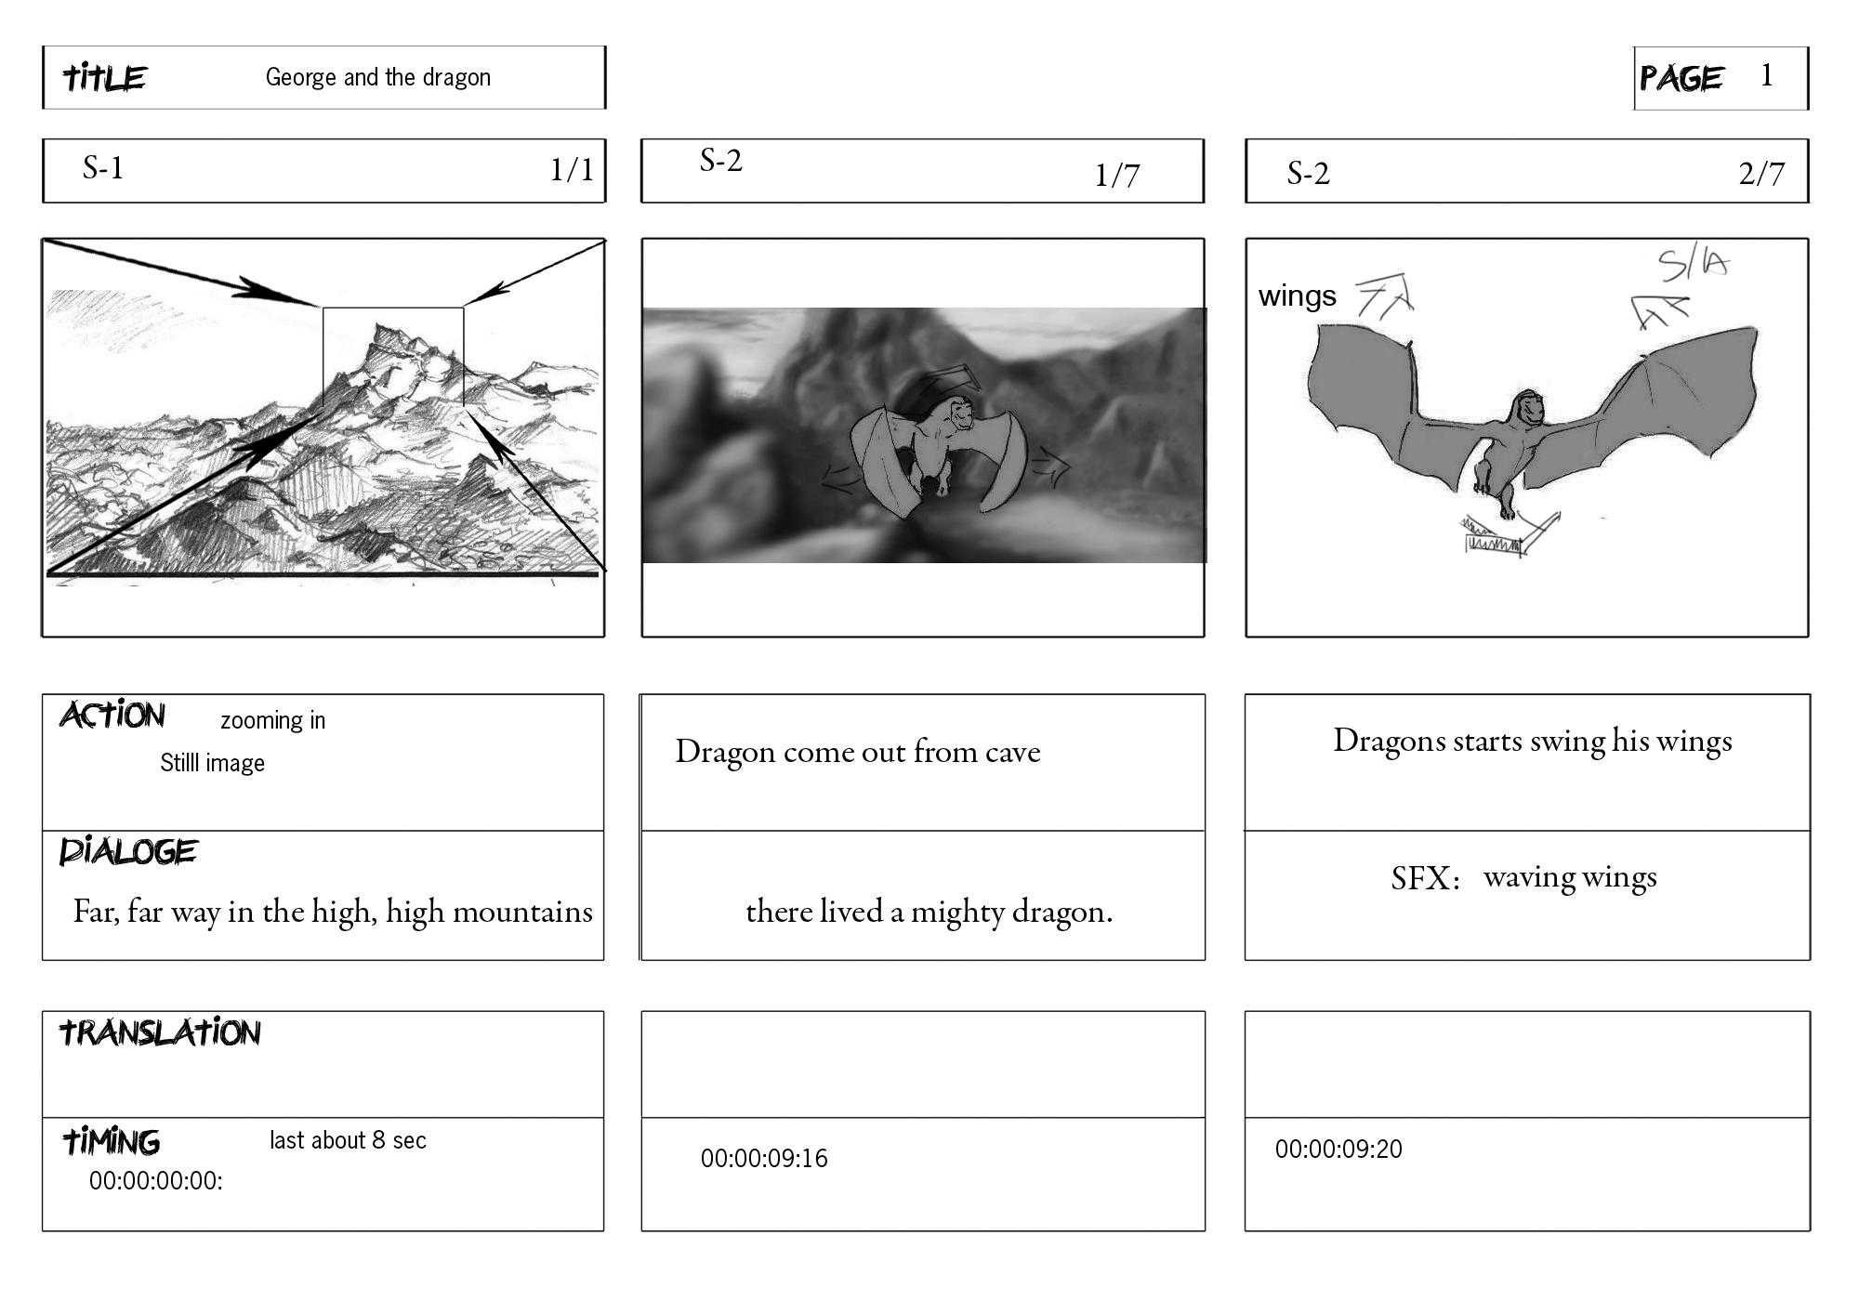
Storyboard

Slide 4
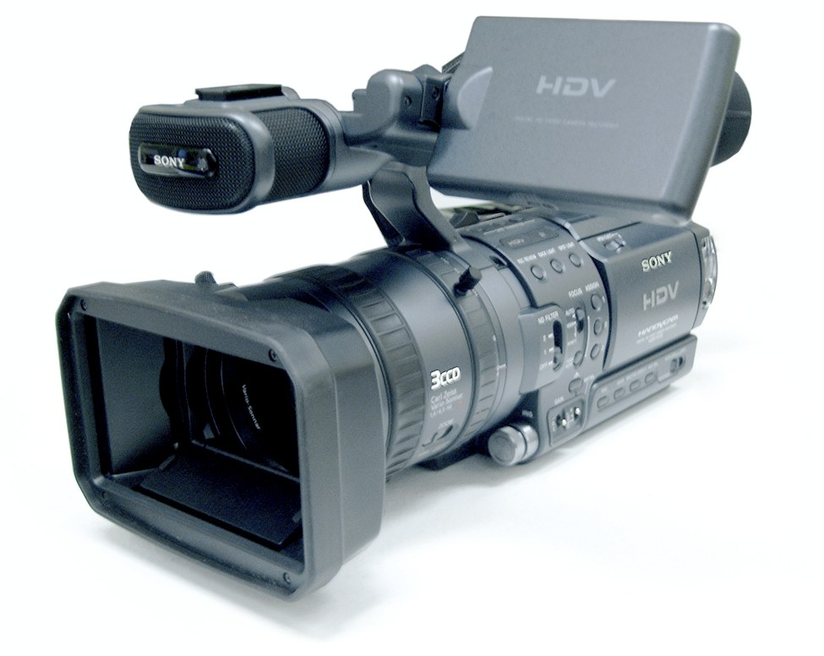
Production
Setup equipment such as tripods, cameras, and lighting.
Record footage according to the storyboard.
Save and organize recorded video.

Slide 5
Post-Production
Import recorded footage into the video editing software or gather existing footage from outside sources.
Select, edit, and assemble the video clips according to the storyboard.
Adjust audio levels, add titles, add transitions to the video clips to convey the intended message to the audience.

Slide 6
Post-Production
Optimize and export the video output file for specific client needs, including:
Primary use of video production
File size requirements
File format requirements

